Slide 1
From Growth to Change:
A Look at Demographic Trends in Texas
March 24, 2026
Texas Automobile Dealers Association
Austin, Texas

Slide 2




About our organization
Major Function
Produce annual population estimates and biennial population projections
Other Services
Disseminate demographic and socioeconomic information from the Census Bureau and other reliable sources.
Provide training and technical expertise.
Custom data analyses.
State Demographer
Lloyd B. Potter, Ph.D.
Affiliated with
The University of Texas at San Antonio
Partnerships
U.S. Census Bureau
TDC Affiliates

Slide 3
Population Growth

Slide 4


Texas Numeric Growth
Texas’s population surpassed
31.7 million
and ranked #1
in the U.S. on numeric growth
between 2024-2025.
Source: U.S. Census Bureau, Vintage 2024 Population Estimates

Slide 5

New 2025 Estimates Show Texas Growth but at Slower Rate
Newly Released Data
Texas Total Population 2025
31.7M
391K
1.2%
Numeric increase
Percent increase
Growth from 2024
New Census Bureau data shows Texas’ population reached 31.7 million in July 2025 — a 1.2% increase from 2024 to 2025, more than 2X the 0.5% national growth rate. Though growth slowed compared to recent years, TX still led the nation in numeric gains, adding over 391K residents.

Slide 6
Texas Daily Population Growth and Components of Change 2020-2025
Drop in Net Migration Slows Texas Population Growth
917
1,494
1,647
1,642
1,072
Daily Average Population Change
Source: U.S. Census Bureau, Vintage 2025 Population Estimates

Slide 7

Population increased by
1,072 new Texans daily
between 2024 and 2025.
Source: U.S. Census Bureau, Population Estimates, 2022 and 2023

Slide 8
Texas Components of Population Change 2024-2025
1,072 New Texans Daily
Source: U.S. Census Bureau, Vintage 2025 Population Estimates

Slide 9
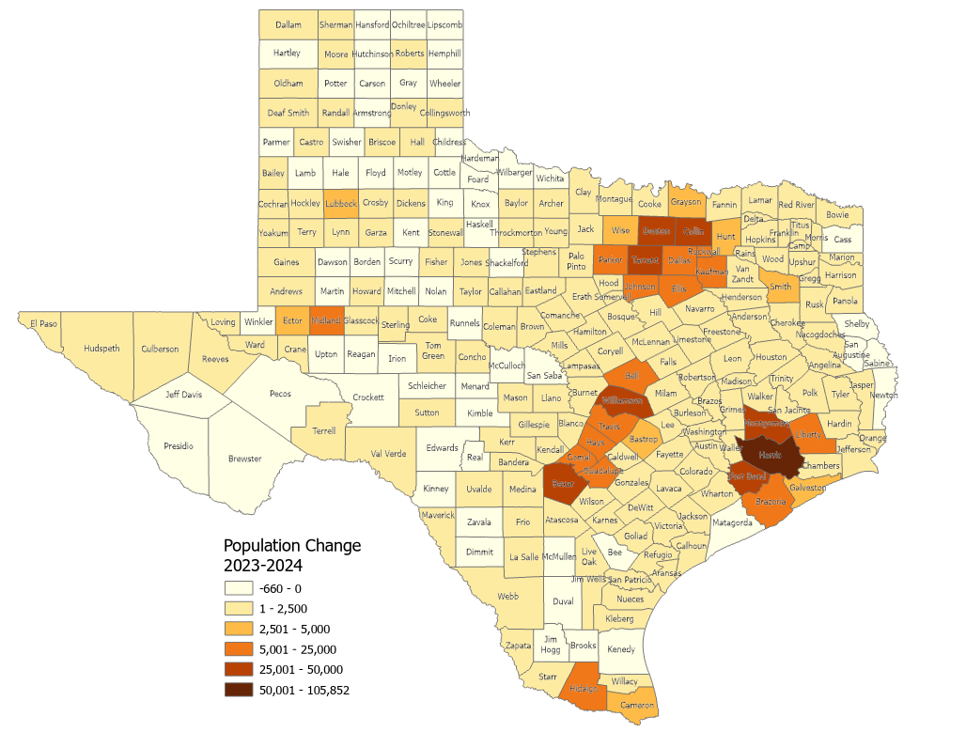
Estimated Numeric Change, Texas Counties, 2023-2024
65 (26.5%) of Texas counties lost population
Source: U.S. Census Bureau, Vintage 2023 and 2024 Population Estimates

Slide 10
Texas Counties With the Largest Numeric Growth
From 2023 to 2024 and Ranks in the U.S.
National
Ranking
County
1
4
9
10
12
13
15
22
32
42
Source: U.S. Census Bureau, Vintage 2024 Population Estimates

Slide 11
Texas Counties With the Fastest Growth Rate From
2023 to 2024 and Their Ranks in the U.S.
National
Ranking
County
2
6
7
9
12
14
15
17
20
21
Source: U.S. Census Bureau, Vintage 2024 Population Estimates
Notes:
Caption: Texas keeps growing! Kaufman County ranks #2 in the nation with a 6.0% growth rate between 2023 and 2024, followed by Liberty, Montgomery, Caldwell, and more. All the fastest-growing counties are located in the suburban rings around the urban core counties in the Texas Triangle.

Slide 12
Texas Cities by Largest Numeric Growth from 2023 to 2024 and National Ranking
National
Ranking
City
1
2
3
4
8
9
10
11
18
21
Source: U.S. Census Bureau, Vintage 2024 Population Estimates

Slide 13
Texas Cities with the Fastest Growth Rate from
2022-2023 and Ranks in the U.S.
National
Ranking
City
1
2
3
4
8
9
10
11
18
21
Note: Ranked among cities with resident population of 20,000 and over.
Source: U.S. Census Bureau, Population Estimates, 2023 Vintage

Slide 14
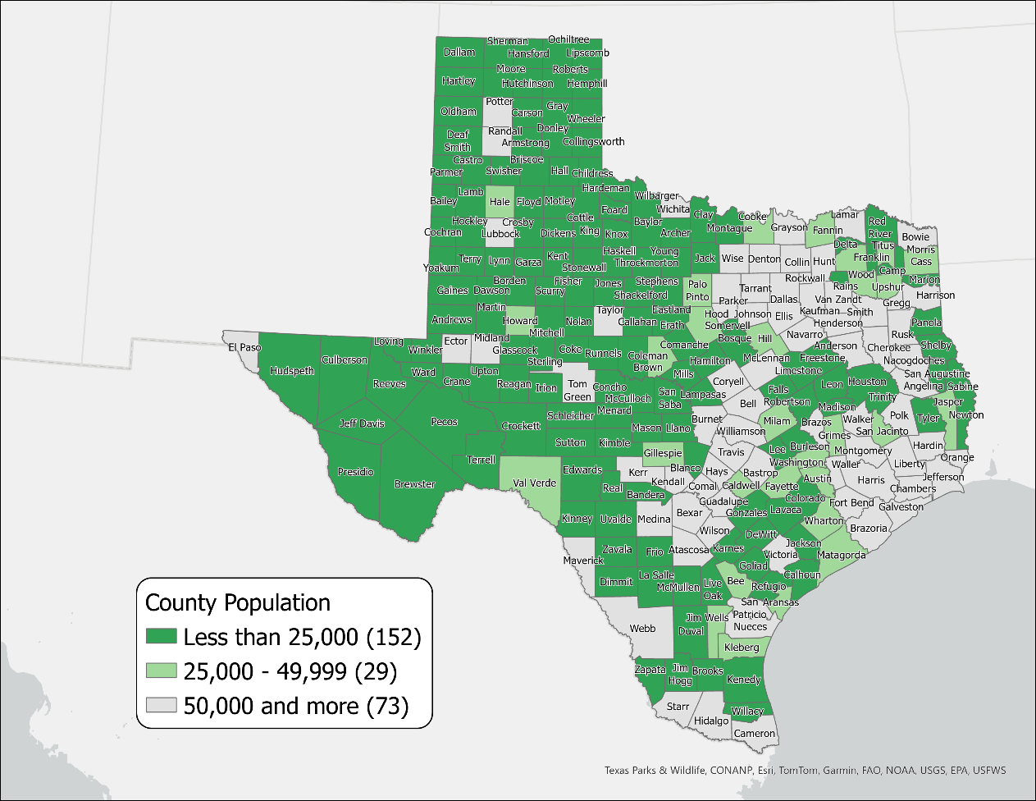
Texas Rural Counties by Population, 2023
181 Rural Counties
Total pop.= 2.4 million (8.1% of Texas pop.)
88 of these counties lost population between 2020-2023
SOURCE: US Census Bureau, Population Estimates, 2022 Vintage

Slide 15
The Drivers of Population Growth

Slide 16
Total Fertility Rate Trends of the U.S. and Texas, 2000-2022
Source: National Vital Statistics Reports, Centers for Disease Control and Prevention
Note: The total fertility rate is a demographic indicator that estimates the average number of children a woman will have during her childbearing years..

Slide 17
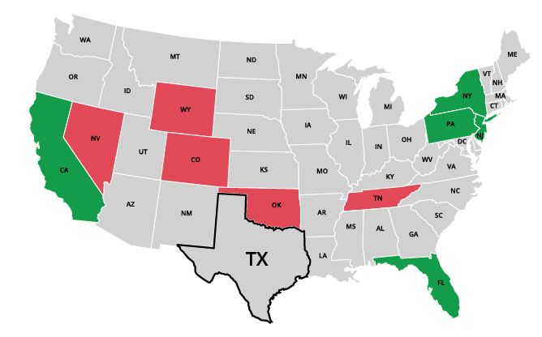
Top Net Migration To and From Texas: Leading States in 2024
Moving to Texas
California | 31,714
2. New York | 11,909
3. New Jersey | 8,148
4. Florida | 6,960
5. Pennsylvania | 5,730
Leaving Texas
1. Oklahoma | -9,495
2. Tennessee | -5,210
3. Colorado | -4,588
4. Wyoming | -2,342
5. Nevada | -2,180
Source: U.S. Census Bureau, 2024 State-to-State Migration Flows Statistics.
Notes:
Note: Data displayed are estimates based on a sample survey and are subject to error.
Caption: Latest U.S. Census Bureau Data: Around 550K domestic migrants moved to Texas in 2024, while 480K left for other states. Texas saw the largest net inflows of migrants from California, New York, and New Jersey and net outflows to Oklahoma, Tennessee, and Colorado.

Slide 18
Demographic Change and Demand for Services

Slide 19
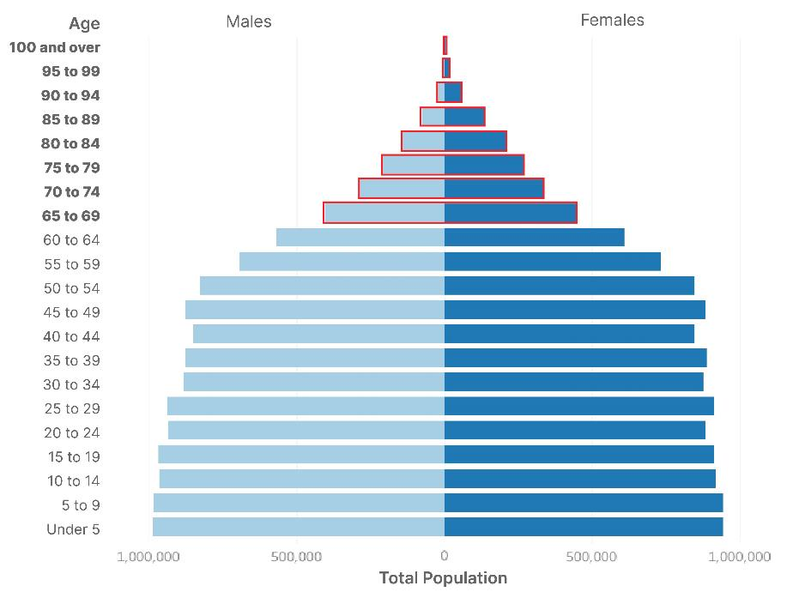
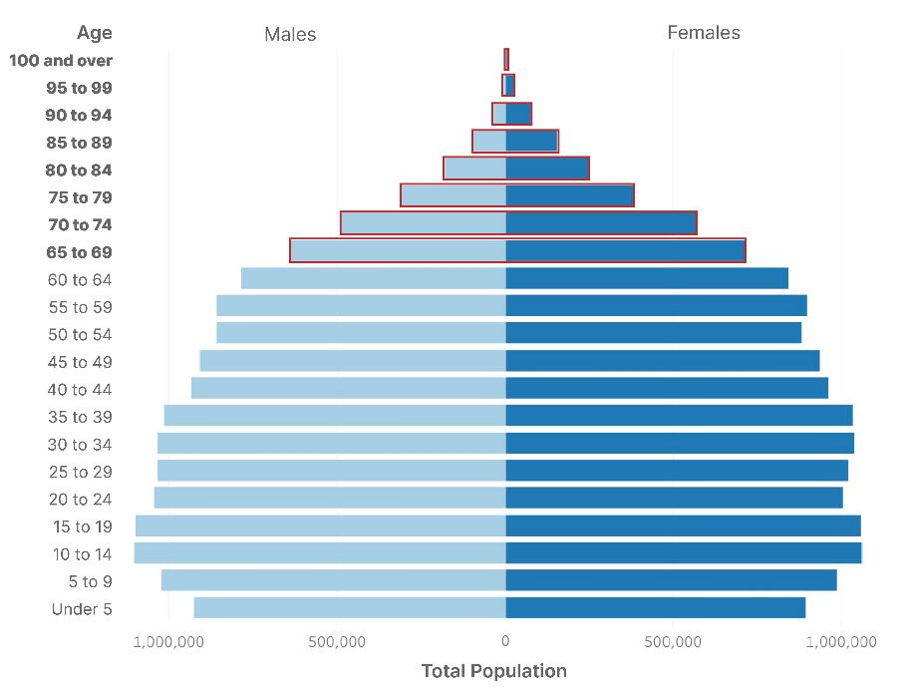
Texas Population Pyramid
2010
2020
% Population 65+:
10.3%
Population 65+:
2.6M
% Population 65+:
13.5%
Population 65+:
3.9M
Population: 25,145,561 | Median Age: 33.6 | % under 18 years: 27.3
Population: 29,145,505 | Median Age: 35.6 | % under 18 years: 25.0
Source: U.S. Census Bureau, Census 2000 Summary File 1 (SF1), 2010 Census Summary File 1 (SF1), 2020 Census Demographic and Housing Characteristics File (DHC)

Slide 20
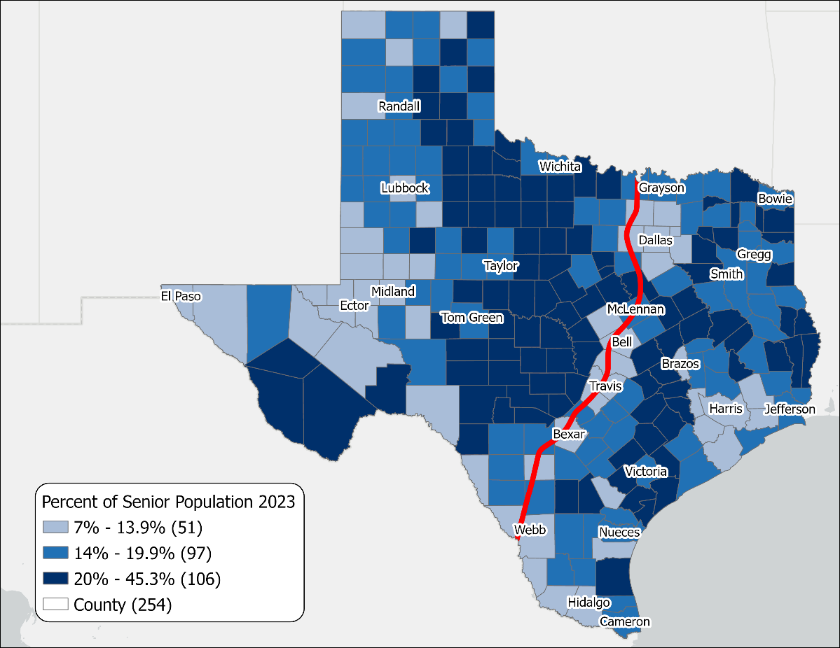

Percent of Senior Population 65+ in Texas, 2023
Source: U.S. Census Bureau. Vintage 2023 Population Estimates.
Notes:
*Super-aged is a term used by the United Nations when the percent of the population 65 and older is above 20%.
Caption: National Senior Citizens Day: celebrate Texas’s 4 million+ seniors! The 65+ population rose from 11.2% (2013) to 13.7% (2023). Remarkably, 40% of TX counties, mostly non-metro, are now “super-aged” (20%+ seniors). This shift underscores the need for tailored services and support.

Slide 21

Median Household Income and Home Value
Gap Widens in Texas, 2013-2023
Median
Home
Value
Median
Household
Income
$
$
$
Source: U.S. Census Bureau, American Community Survey, 1-Year, 2013, 2018, and 2023.
Note: 2023 Inflation-Adjusted Dollars.
Notes:
The median household income has not kept up with the cost of housing in TX. Population growth, rising costs for building materials, and labor shortages have affected the supply of homes and increased their cost, making it difficult for many Texans to purchase and own a home.

Slide 22
Median Home Value in Texas MSAs, 2013 and 2023
Texas
Source: U.S. Census Bureau, American Community Survey, 1-Year, 2013 and 2023.
Note: Top 10 most populous Metropolitan Statistical Areas (MSAs) featured. Data represented in 2023 inflation-adjusted dollars.
Notes:
Note: Top 10 most populous Metropolitan Statistical Areas (MSAs) featured. Data represented in 2023 inflation-adjusted dollars.
Caption: Population growth drove housing demand and costs in TX, raising median home values by 72% since 2013. Among the largest MSAs, Dallas-Ft. Worth-Arlington saw the highest percentage increase at 87%. Addressing housing affordability is crucial for the state's economic growth.

Slide 23








Housing Tenure and Costs in Texas, 2024
11.4 million occupied housing units
Homeowners
Renters
62.3% homeowners in Texas
37.7% renters in Texas
Median mortgage: $2,211/month
Median rent: $1,475/month
Cost burden: 31%
Cost burden: 53%
Source: U.S. Census Bureau, 2024 American Community Survey, 1-Year Estimates

Slide 24
Percent Uninsured by Race/Ethnicity, Texas 2024
16.7% of Texans are without health insurance
TX has the highest uninsured rate in the US
Source: U.S. Census Bureau, American Community Survey, 2024 1-year estimates

Slide 25
Mean Commuting Time in Texas and Major Cities (2014-2024)
minutes
Source: U.S. Census Bureau, American Community Survey Estimates, 1-Year, 2014 – 2024.
Notes:
NOTE: Commute times reflected are for residents who live within city boundaries and not for individuals who work in these cities but reside elsewhere.
Caption: Average commute times in Texas rose before the pandemic, dipped after, and are climbing again. Houston and Fort Worth still have the longest one‑way trips, while Austin and San Antonio remain the shortest. By 2024, most major cities are back to (or above) pre‑pandemic levels.

Slide 26
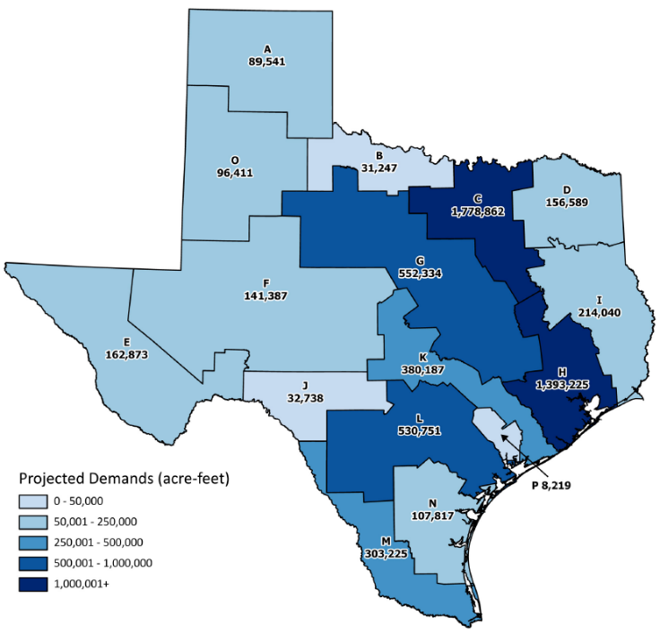
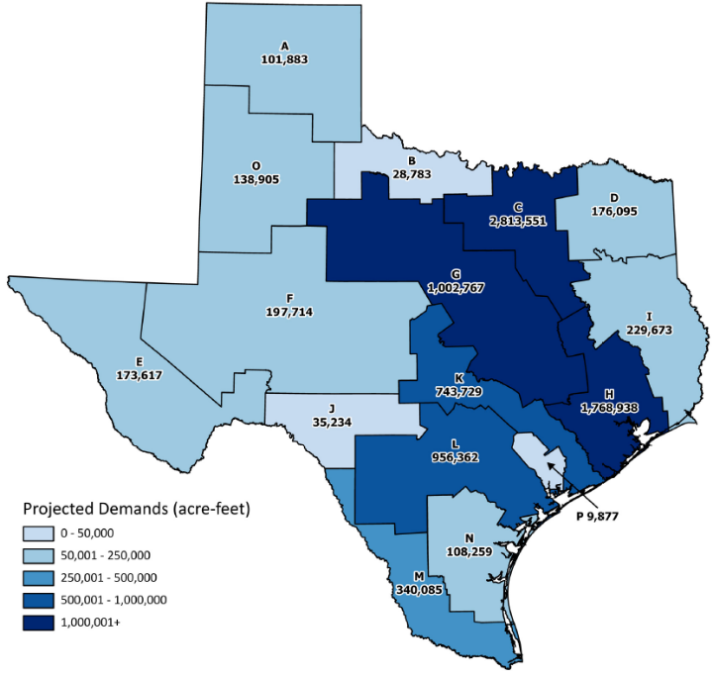
Projected Municipal Water Demands
2030
2080
Source: 2022 State Water Plan, Texas Water Development Board

Slide 27
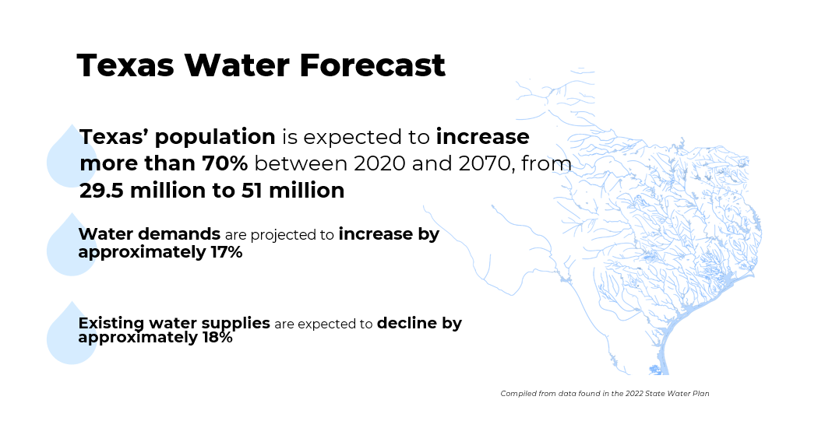
Texas Water Forecast
Source: 2022 State Water Plan, Texas Water Development Board

Slide 28
A Look at the Economy

Slide 29
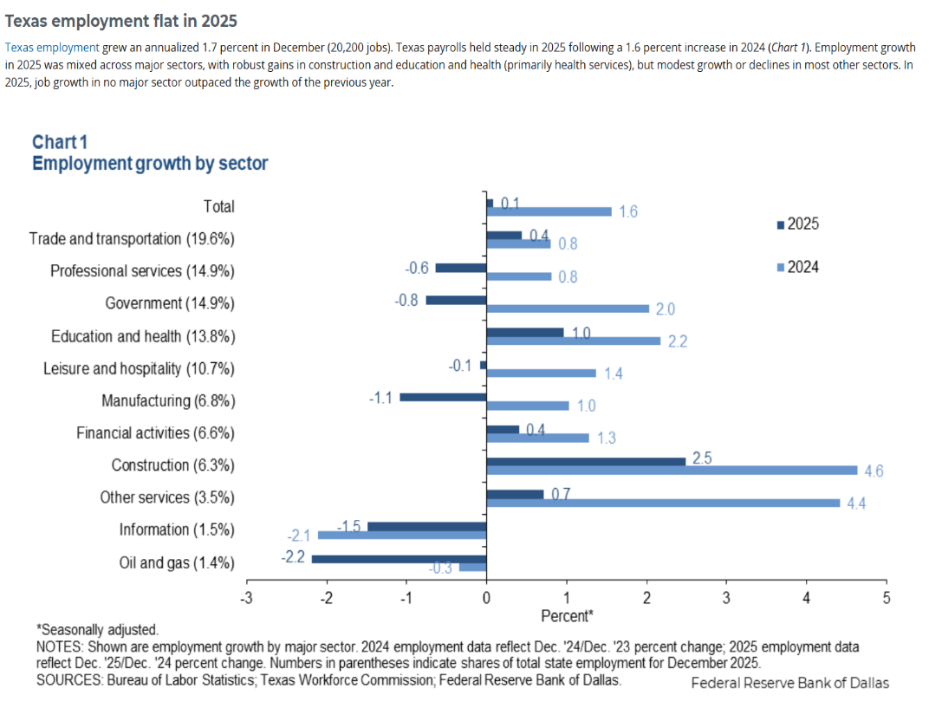
Employment by Sector 2025
Employment growth in education and health (+1% change)
Construction growth (+2.5%)
Declines in Oil and Gas (-2.2%), Information sector (-1.5%), and Manufacturing (-1.1%)
Job growth in no major sector outpaced the growth from the previous year (2024)
Source: Federal Reserve Bank of Dallas, Texas Economic Indicators, Feb. 12, 2026

Slide 30
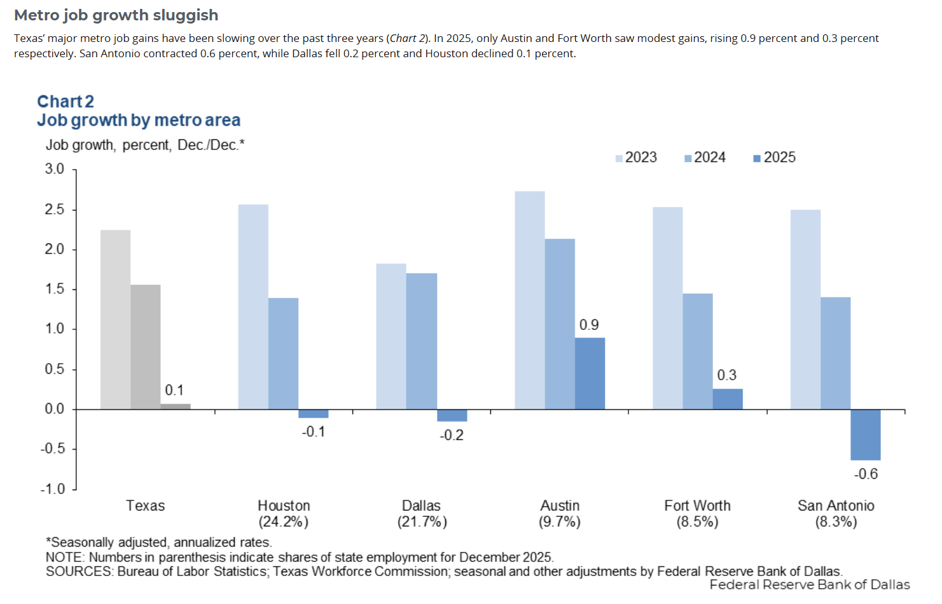
Metro Job Growth Sluggish
Source: Federal Reserve Bank of Dallas, Texas Economic Indicators, Feb. 12, 2026

Slide 31
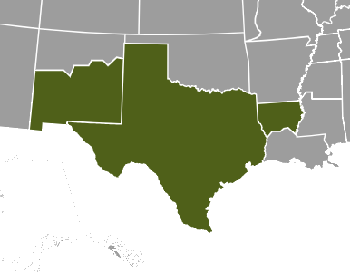
Dallas Federal Reserve Beige Book
Eleventh District Region March 4, 2026
Economic activity expanded moderately over the reporting period.
Manufacturing output grew robustly both in nondurable and durable production. Price pressure elevated for both raw materials and finished goods.
Bank loan volume continued to increase, supported entirely by commercial real estate loans.
Employment grew slightly; however, 55% of businesses are not trying to hire workers.
Demand for nonprofit services remained high amid uncertainty regarding government funding and potential increase in uninsured with ACA subsidies expiring.
Outlooks remained steady despite persistently elevated uncertainty.
Source: Dallas Federal Reserve, Eleventh District Region, Beige Book, March 4. 2026
NOTE: Based on anecdotal information on current economic conditions and interviews with key business contacts, economists, market experts, and other sources.

Slide 32
A Look into the Future

Slide 33
Projected Population Growth in Texas with Various Migration Scenarios
2020-2060
42.6 million by 2060
Source: Texas Demographic Center, Vintage 2022 and 2024 Population Projections

Slide 34
Texas Projected Population by Age, 2020-2060
Share of population 65+ will continue to increase
22%
18%
13%
60%
60%
62%
25%
21%
18%
Total Population
29.1M
37.1M
42.6M
Source: Texas Demographic Center, Vintage 2024 Population Projections, Mid-Migration Scenario.
Notes:
Caption: New TDC Vintage 2024 projections show Texas will continue to age in the next few decades. The 65+ group will grow fastest. Growth among those under18 will slow and begin to decline. The working-age population will grow and maintain a stable share of the total population.

Slide 35
Projected Population by Race/Ethnicity in Texas
Share of Hispanic population will continue to increase
42.6 million by 2060
Source: Texas Demographic Center, Vintage 2024 Population Projections, Mid-Migration Scenario

Slide 36
In summary:
Since the 2020 Decennial Census, Texas has consistently ranked #1 in the country in numeric growth.
Population growth has been driven by migration (international and domestic).
The Texas population is getting older, but at a slower rate than other states in the U.S.
Hispanics make up the greatest share of the population.
Monitoring demographic growth and trends will help us:
  Manage our natural resources;
  Develop infrastructure to support the economy;
  Expand vital services for the well-being of all Texans.

Slide 37




Visit our website
Sign up for our newsletter
Follow us on social media

Slide 38
Monica Cruz, Ph.D.
(210) 458-6543
tdc@utsa.edu
demographics.texas.gov/

