Slide 1
Demographic Trends and Characteristics: Texas and the North Texas Region
February 12, 2026
Plano, Texas
Presented to:
Leadership Plano

Slide 2




About our organization
Major Function
Produce annual population estimates and biennial population projections
Other Services
Disseminate demographic and socioeconomic information from the Census Bureau and other reliable sources.
Provide training and technical expertise.
Custom data analyses.
State Demographer
Lloyd B. Potter, Ph.D.
Affiliated with
The University of Texas at San Antonio
Institute for Demographic and Socioeconomic Research (IDSER)
Partnerships
U.S. Census Bureau
TDC Affiliates

Slide 3


Texas Numeric Growth
Texas’s population surpassed
31.7 million
and ranked #1
in the U.S. on numeric growth
between 2024-2025.
Source: U.S. Census Bureau, Vintage 2024 Population Estimates

Slide 4

New 2025 Estimates Show Texas Growth but at Slower Rate
Newly Released Data
Texas Total Population 2025
31.7M
391K
1.2%
Numeric increase
Percent increase
Growth from 2024

Slide 5

Population increased by
1,072 new Texans daily
between 2024 and 2025.
Source: U.S. Census Bureau, Population Estimates, 2022 and 2023

Slide 6
Texas Components of Population Change 2024-2025
1,072 New Texans Daily
Source: U.S. Census Bureau, Vintage 2025 Population Estimates

Slide 7
Texas Daily Population Growth and Components of Change 2020-2025
Drop in Net Migration Slows Texas Population Growth
917
1,494
1,647
1,642
1,072
Daily Average Population Change
Source: U.S. Census Bureau, Vintage 2025 Population Estimates

Slide 8
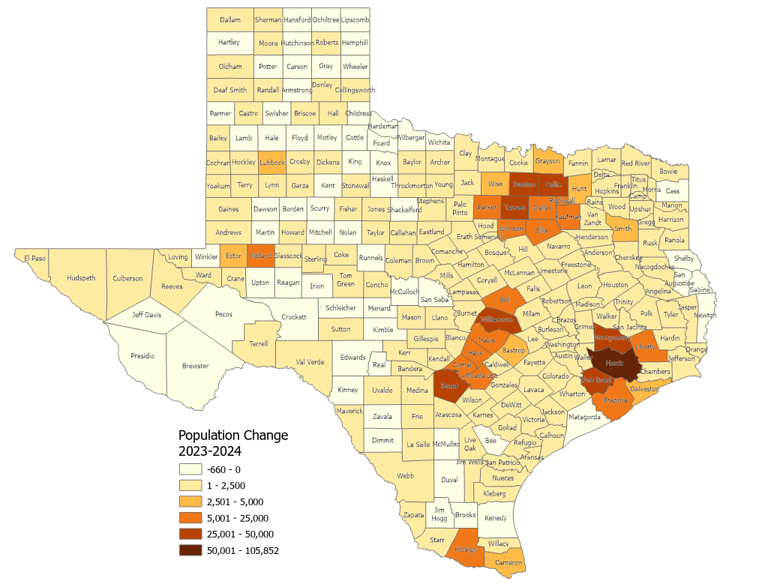
Estimated Numeric Change, Texas Counties, 2023-2024
65 (26.5%) of Texas counties lost population
Population Change
2023-2024
-660 - 0
1 – 2,500
2,501 – 5,000
5,001 – 25,000
25,001 – 50,000
50,001 – 105,852
Source: U.S. Census Bureau, Vintage 2023 and 2024 Population Estimates

Slide 9
Texas Counties With the Largest Numeric Growth
From 2023 to 2024 and their National Ranking
National
Ranking
County
1
4
9
10
12
13
15
22
32
42
Source: U.S. Census Bureau, Vintage 2024 Population Estimates

Slide 10
Texas Counties With the Fastest Growth Rate From
2023 to 2024 and Ranks in the U.S.
National
Ranking
County
2
6
7
9
12
14
15
17
20
21
Source: U.S. Census Bureau, Vintage 2024 Population Estimates

Slide 11
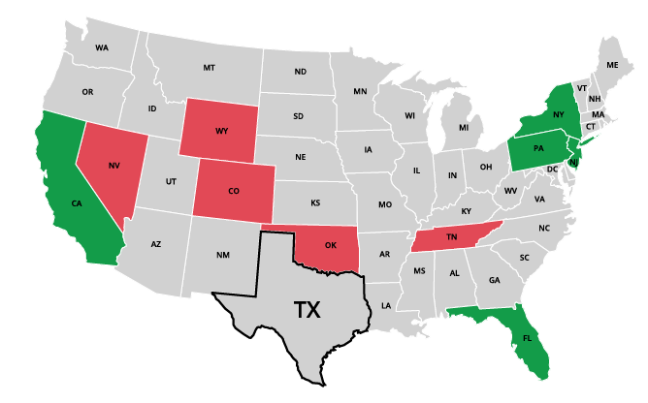
Top Net Migration To and From Texas: Leading States in 2024
Moving to Texas
California | 31,714
2. New York | 11,909
3. New Jersey | 8,148
4. Florida | 6,960
5. Pennsylvania | 5,730
Leaving Texas
1. Oklahoma | -9,495
2. Tennessee | -5,210
3. Colorado | -4,588
4. Wyoming | -2,342
5. Nevada | -2,180
Source: U.S. Census Bureau, 2024 State-to-State Migration Flows Statistics.
Notes:
Note: Data displayed are estimates based on a sample survey and are subject to error.
Caption: Latest U.S. Census Bureau Data: Around 550K domestic migrants moved to Texas in 2024, while 480K left for other states. Texas saw the largest net inflows of migrants from California, New York, and New Jersey and net outflows to Oklahoma, Tennessee, and Colorado.

Slide 12
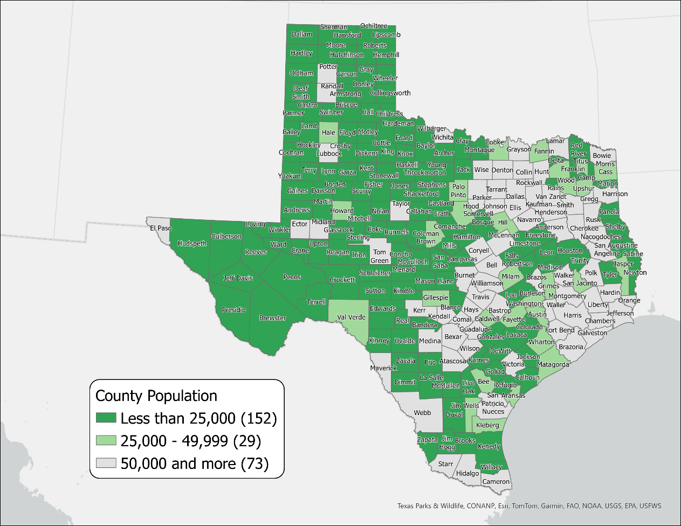
Texas Rural Counties by Population, 2023
181 Rural Counties
Total pop.= 2.4 million (8.1% of Texas pop.)
88 of these counties lost population between 2020-2023
SOURCE: US Census Bureau, Population Estimates, 2022 Vintage

Slide 13
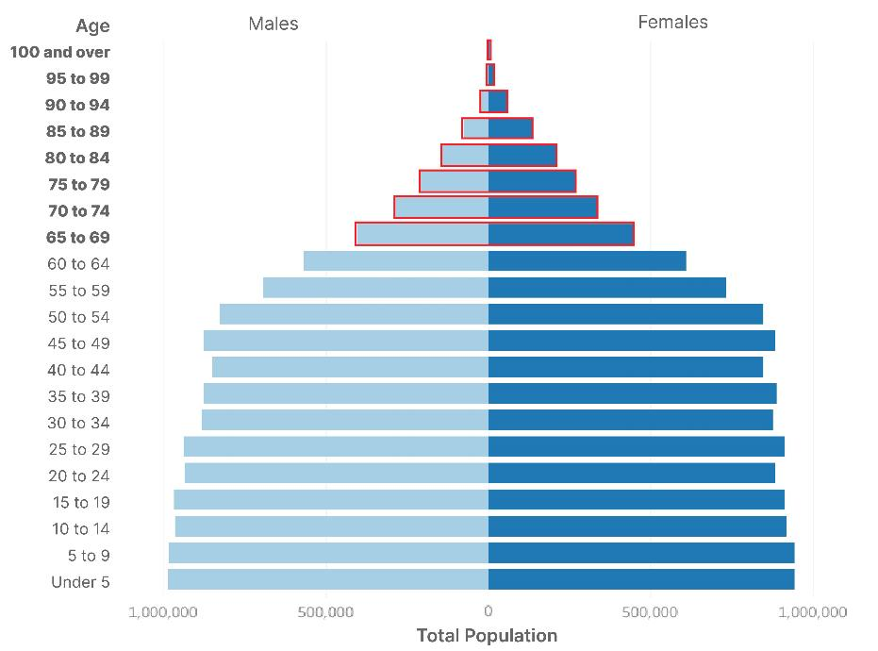
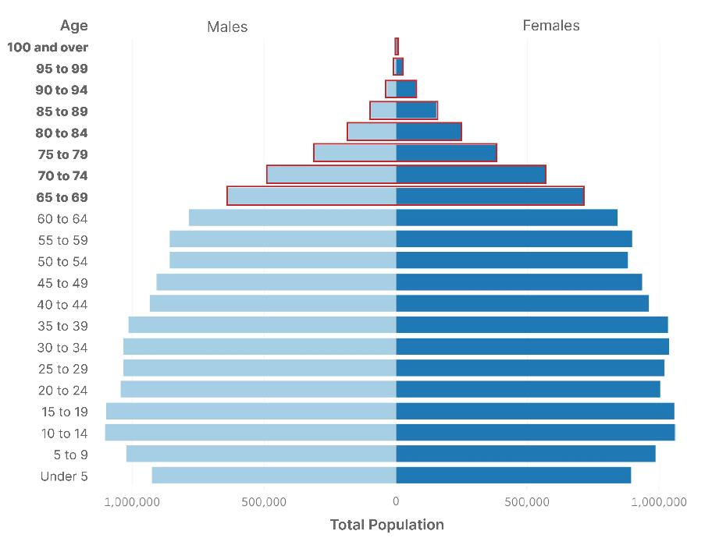
Texas Population Pyramid
2010
2020
% Population 65+:
10.3%
Population 65+:
2.6M
% Population 65+:
13.5%
Population 65+:
3.9M
Population: 25,145,561 | Median Age: 33.6 | % under 18 years: 27.3
Population: 29,145,505 | Median Age: 35.6 | % under 18 years: 25.0
Source: U.S. Census Bureau, Census 2000 Summary File 1 (SF1), 2010 Census Summary File 1 (SF1), 2020 Census Demographic and Housing Characteristics File (DHC)

Slide 14
Total Fertility Rate Trends of the U.S. and Texas, 2000-2022
Source: National Vital Statistics Reports, Centers for Disease Control and Prevention
Note: The total fertility rate is a demographic indicator that estimates the average number of children a woman will have during her childbearing years..

Slide 15
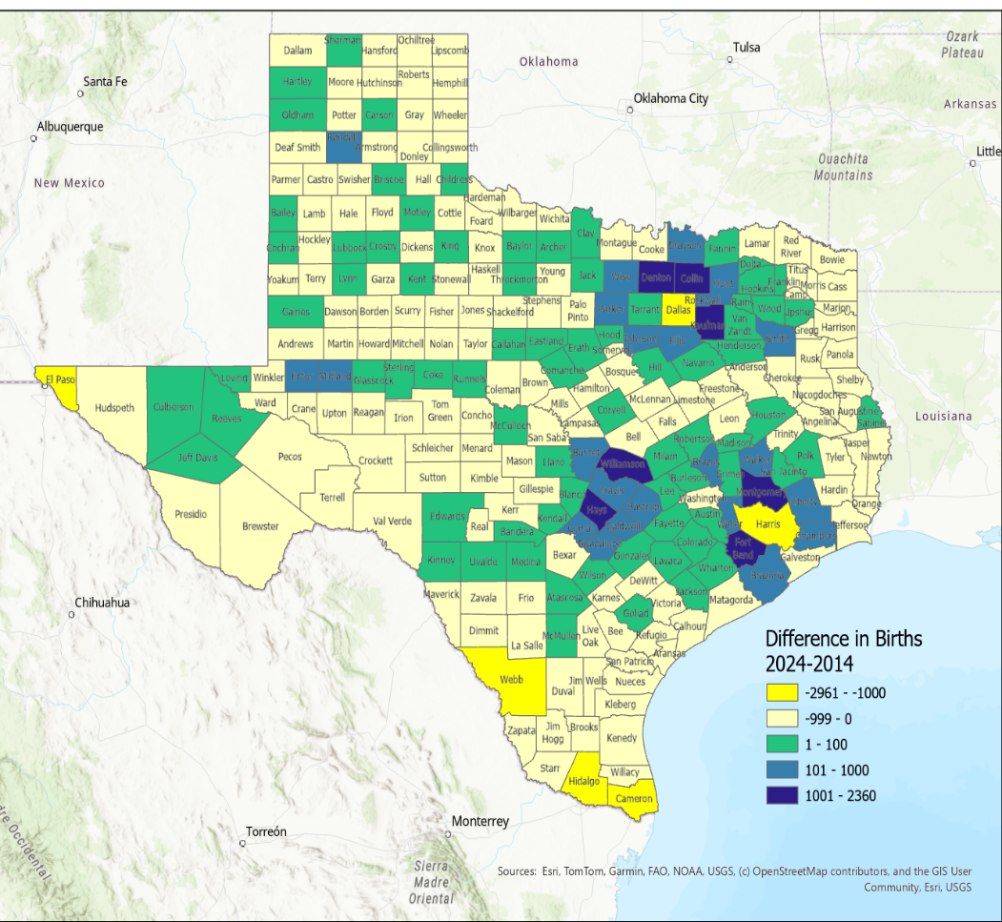
Difference in Estimated Number of Births Between 2024 and 2014, Texas Counties
Source: U.S. Census Bureau, Vintage 2014 and 2024 Population Estimates

Slide 16
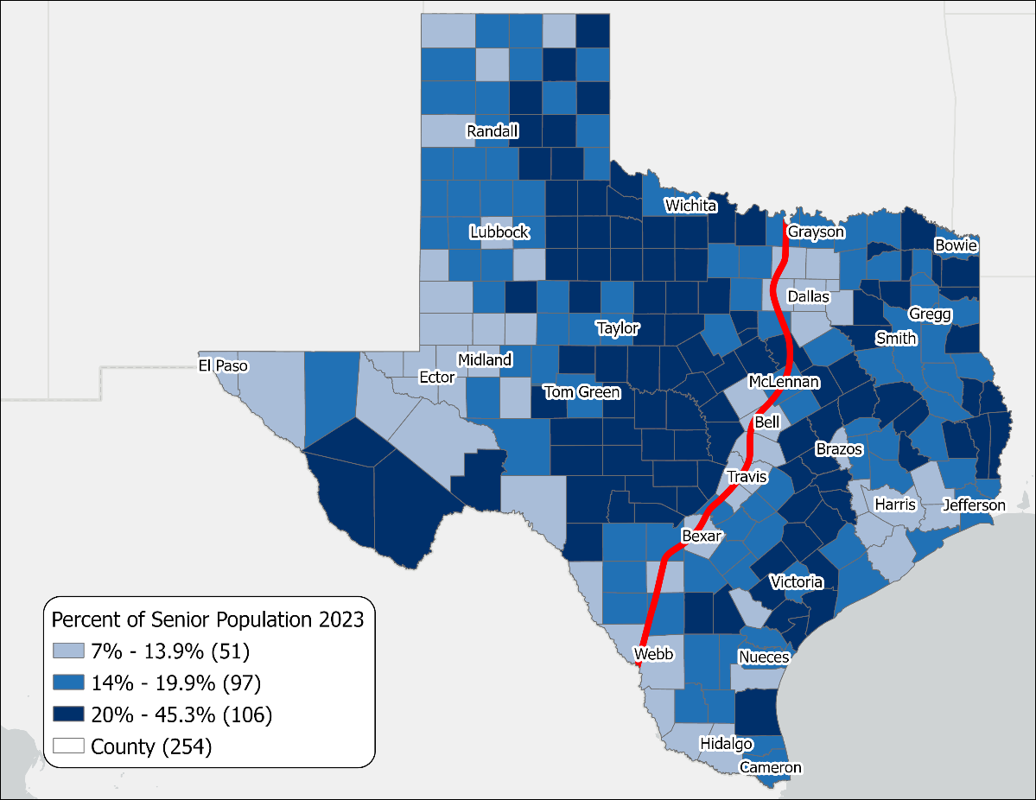

Percent of Senior Population 65+ in Texas, 2023
Source: U.S. Census Bureau. Vintage 2023 Population Estimates.
Notes:
*Super-aged is a term used by the United Nations when the percent of the population 65 and older is above 20%.
Caption: National Senior Citizens Day: celebrate Texas’s 4 million+ seniors! The 65+ population rose from 11.2% (2013) to 13.7% (2023). Remarkably, 40% of TX counties, mostly non-metro, are now “super-aged” (20%+ seniors). This shift underscores the need for tailored services and support.

Slide 17

Median Household Income and Home Value
Gap Widens in Texas, 2013-2023
Median
Home
Value
Median
Household
Income
$
$
$
Source: U.S. Census Bureau, American Community Survey, 1-Year, 2013, 2018, and 2023.
Note: 2023 Inflation-Adjusted Dollars.
Notes:
The median household income has not kept up with the cost of housing in TX. Population growth, rising costs for building materials, and labor shortages have affected the supply of homes and increased their cost, making it difficult for many Texans to purchase and own a home.

Slide 18
Percent Uninsured by Race/Ethnicity, Texas 2024
16.7% of Texans are without health insurance
TX has the highest uninsured rate in the US
Source: U.S. Census Bureau, American Community Survey, 2024 1-year estimates

Slide 19
A Look at Your Region

Slide 20
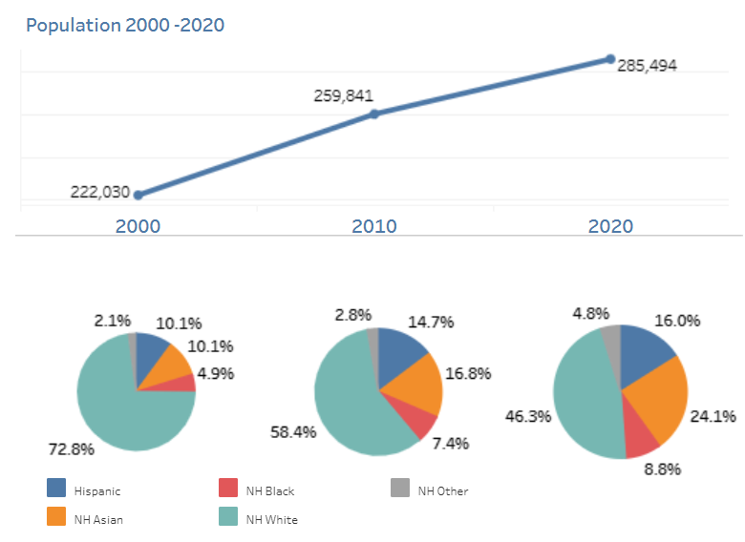
Plano, Texas 2000-2020
Population and Demographic Characteristics
Pop. 292,788
January 2025
Source: U.S. Census Bureau, Decennial Census, 2000, 2010, 2020

Slide 21
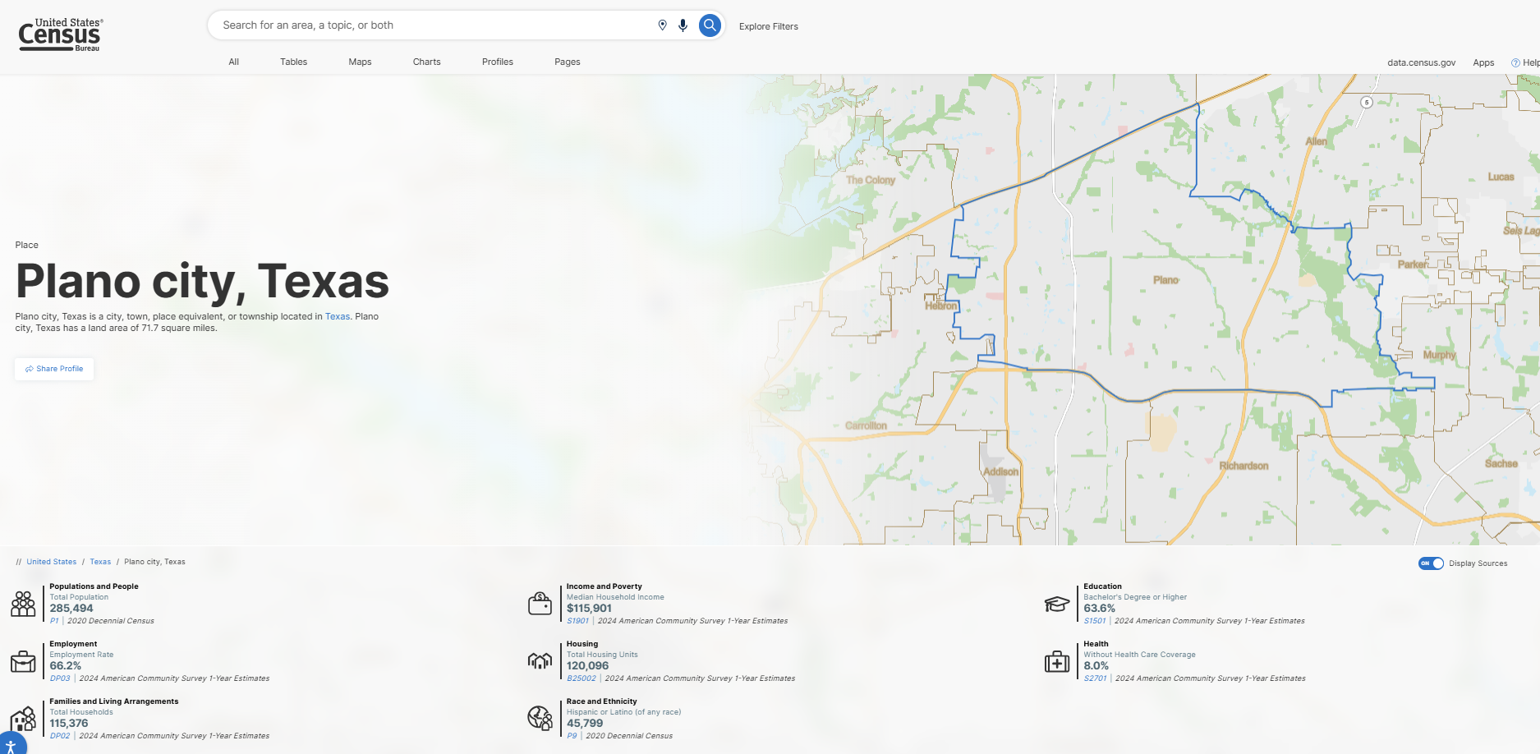
Plano, TX – U.S. Census Bureau Profile
Source: U.S. Census Bureau, data.census.gov
Plano, Texas Profile: Plano city, Texas - Census Bureau Profile

Slide 22
Components of Population Change, 2023-2024,
Collin County
46,694 new residents between 2023-2024
127 new residents per day
Source: US Census Bureau, Population Estimates, 2024 Vintage
1 Total population change includes a residual. This residual represents the change in population that cannot be attributed to any specific demographic component. See Population Estimates Terms and Definitions at https://www.census.gov/programs-surveys/popest/about/glossary.html.

Slide 23
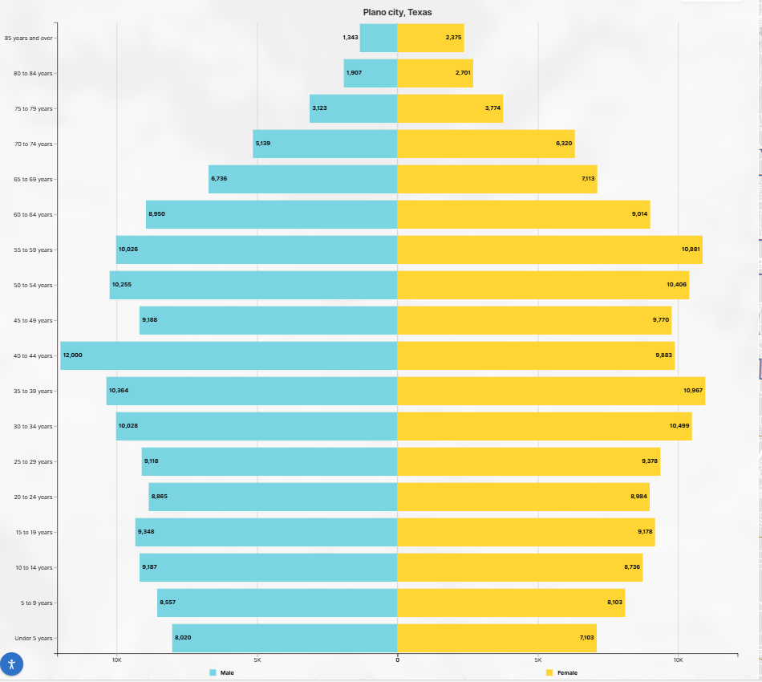
Plano, Texas
Population Pyramid
Median Age in Plano= 40.5
Median Age in TX= 35.9
Source: U.S. Census Bureau, 2023 ACS 5-year Estimates

Slide 24
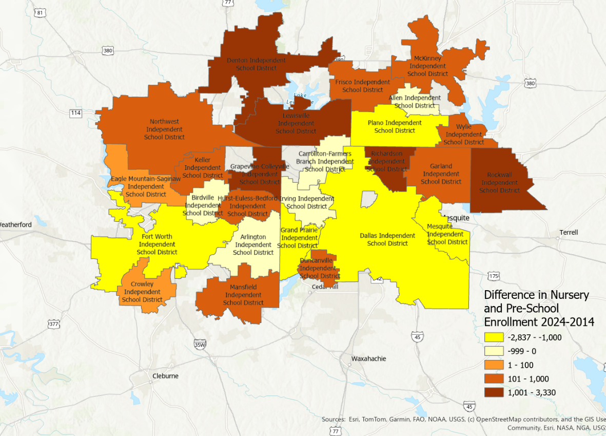
Difference in Estimated Nursery and Pre-School Enrollment 2024 and 2014, Texas School Districts, DFW Metroplex Area
Source: U.S. Census Bureau. American Community Survey 1-Year sample, 2014 and 2024

Slide 25
Percent of the Population with a BA or Higher
Population 25 years and Older
Source: U.S. Census Bureau, 2024 ACS 1-Year Estimates

Slide 26
Median Household Income
Source: U.S. Census Bureau, 2024 ACS 1-Year Estimates

Slide 27
Housing Characteristics
*Cost Burden: When a household spends more than 1/3 of its income on housing costs.
Source: U.S. Census Bureau. "Selected Housing Characteristics." American Community Survey, 2024 ACS 1-Year Estimates Data Profiles, Table DP04

Slide 28
Civilian Employed Population 16 years and over
Class of Worker, Plano, TX, 2022
21% civilian employed population works from home
Source: U.S. Census Bureau, 2024 ACS 1-Year Estimates
Notes:
Other indicators:
Percent who work from home, Williamson County, 20%
Average commuting time to work, 27 minutes

Slide 29
A Look into the Future

Slide 30
Population Projections, DFW Metro Largest and Fast-Growing Counties, 2020-2060
Source: Texas Demographic Center, 2024 Population Projections, Mid-Migration

Slide 31
Population Projections, DFW Metro Largest and Fast-Growing Counties, 2020-2060
Source: Texas Demographic Center, 2024 Population Projections, Mid-Migration

Slide 32
Projected Population Growth in Texas with Various Migration Scenarios
2020-2060
42.6 million by 2060
(Mid migration scenario)
Source: Texas Demographic Center, Vintage 2022 and 2024 Population Projections

Slide 33
Projected Population by Age
2020, 2040, and 2060
Mid Migration Scenario
22%
18%
Texas will continue to age in the next few decades.
The 65+ group will grow fastest.
Growth among those under 18 will slow and begin to decline.
The working-age population will grow and maintain a stable share of the total population.
13%
60%
60%
62%
Total Population
29.1M
37.1M
42.6M
Source: Texas Demographic Center, Vintage 2024 Population Projections, Mid Migration Scenario

Slide 34
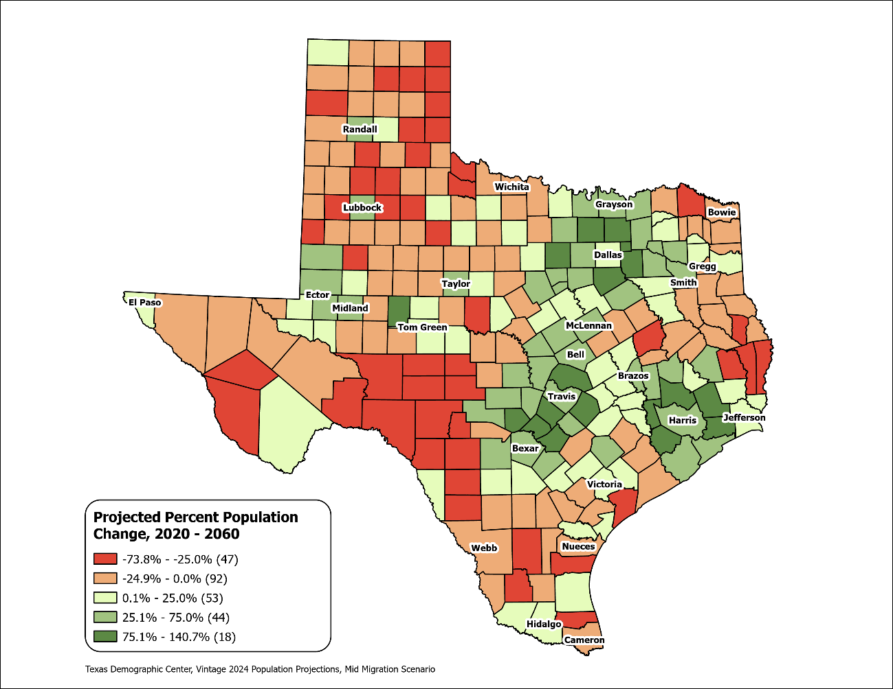
Texas Counties
Projected Population Percent Change 2020-2060
Mid Migration Scenario
Suburban ring counties in the triangle area will see the fastest growth rates.
Source: Texas Demographic Center, Vintage 2024 Population Projections, Mid Migration Scenario

Slide 35
Preparing for the 2030 Census (cont.)
Between 2010- 2020 Texas ranked #1 in numeric growth adding 3.9 million new Texans
YET 2020 Census: Texas was one of 6 states with an undercount (approximately 500K people)
Undercounting the population costs us billions in lost funding for infrastructure, health care, social services
Participate in the 2027 Local Update Census Addresses (LUCA) to ensure the Census Bureau has every address in your city or county.

Slide 36
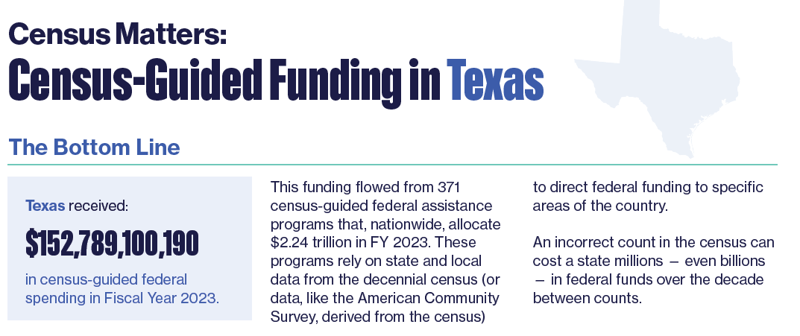
Why Good Population Data Matters
Texas received over
$152 Billion
in Census-guided federal assistance in 2023
Project on Government Oversight report
Source: Census Matters: Why an Accurate Count is Essential to Funding Our Communities | Project On Government Oversight

Slide 37


Slide 38


Texas Demographic Center 2026

Slide 39
Monica Cruz, Ph.D.
(210) 458-6543
tdc@utsa.edu
demographics.texas.gov/

