Slide 1
Current and Future Population Trends
Preparing for 2030 Census
TARC Bi-Annual Staff Training and Board Meeting
Feb 5, 2026

Slide 2




About our organization
Major Function
Produce annual population estimates and biennial population projections
Other Services
Disseminate demographic and socioeconomic information from the Census Bureau and other reliable sources.
Provide training and technical expertise.
Custom data analyses.
State Demographer
Lloyd B. Potter, Ph.D.
Affiliated with
The University of Texas at San Antonio
Partnerships
U.S. Census Bureau
TDC Affiliates

Slide 3


Current and Future Population Trends

Slide 4

New 2025 Estimates Show Texas Growth but at Slower Rate
Newly Released Data
Texas Total Population 2025
31.7M
391K
1.2%
Numeric increase
Percent increase
Growth from 2024
New Census Bureau data shows Texas’ population reached 31.7 million in July 2025 — a 1.2% increase from 2024 to 2025, more than 2X the 0.5% national growth rate. Though growth slowed compared to recent years, TX still led the nation in numeric gains, adding over 391K residents.

Slide 5
Texas Daily Population Growth and
Components of Change 2020-2025
917
1,494
1,647
1,642
1,072
Daily Average Population Change
Source: U.S. Census Bureau, Vintage 2025 Population Estimates

Slide 6
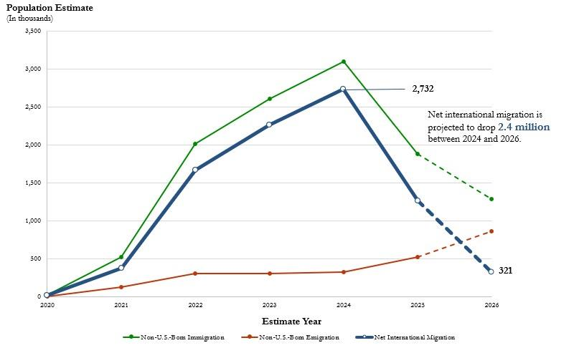
Estimates of Net International Migration Components, 2020 to 2026
Source: https://www.census.gov/newsroom/blogs/random-samplings/2026/01/historic-decline-in-net-international-migration.html.
U.S. Census Bureau, Vintage 2025 Population Estimates. Note: The dashed line from 2025 to 2026 indicates a projection.

Slide 7
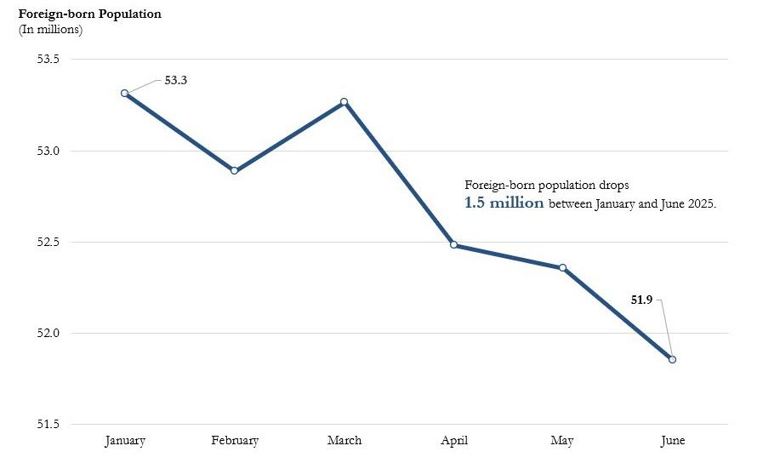
Estimates of the Foreign-Born Population by Month from the Current Population Survey, 2025
Source: https://www.census.gov/newsroom/blogs/random-samplings/2026/01/historic-decline-in-net-international-migration.html
U.S. Census Bureau, Current Population Survey Monthly File, special tabulation.

Slide 8


Vintage 2024 Population Projections
Total population and population by age, race, and sex for Texas and all its counties:
Single year of age;
5 race/ethnic groups: Hispanic, NH White, NH Black, NH Asian, and NH Other;
From the most recent Census (2020) out to 40 years in the future (2060);
Three migration scenarios are provided – low, mid and high.

Slide 9
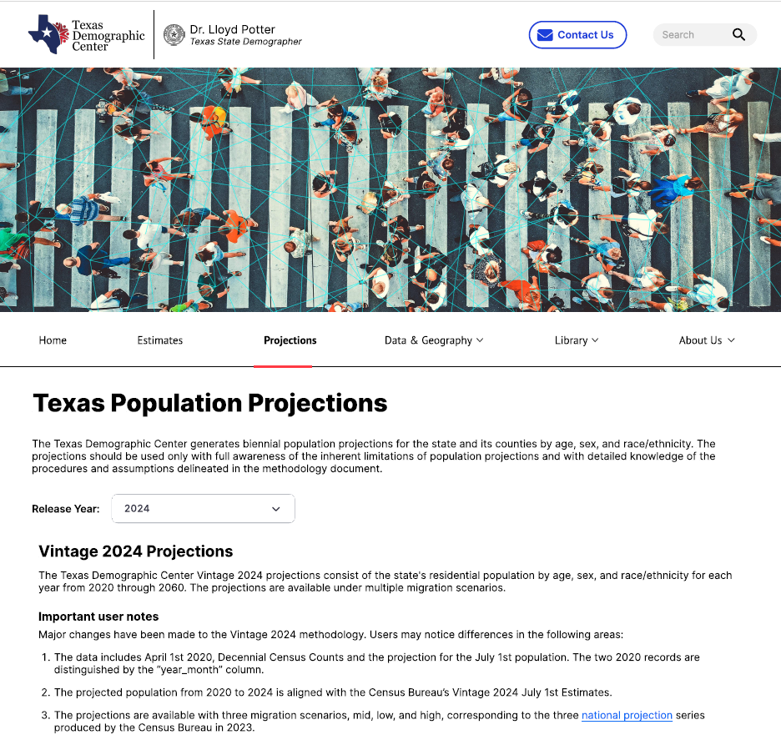
Access the
TDC Projections

Slide 10
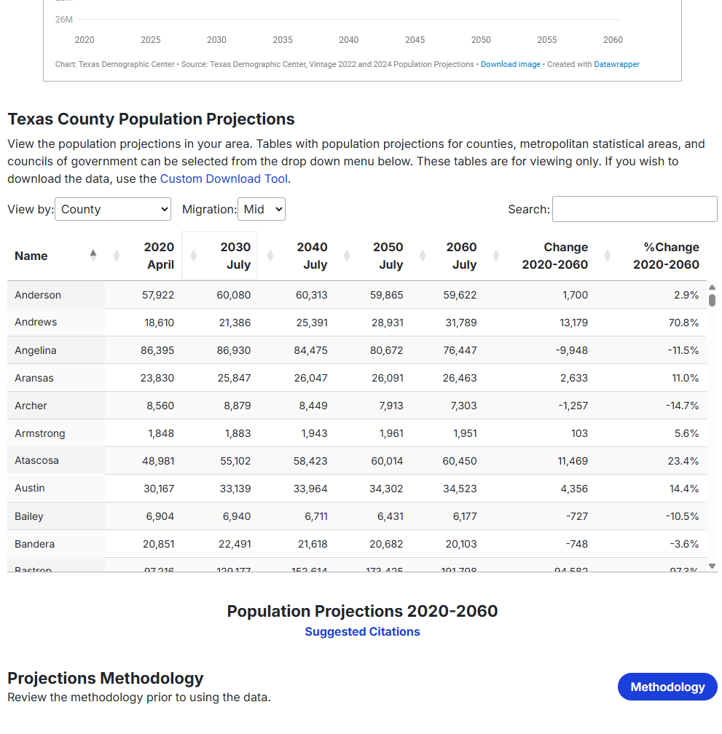
TDC Projections Table

Slide 11
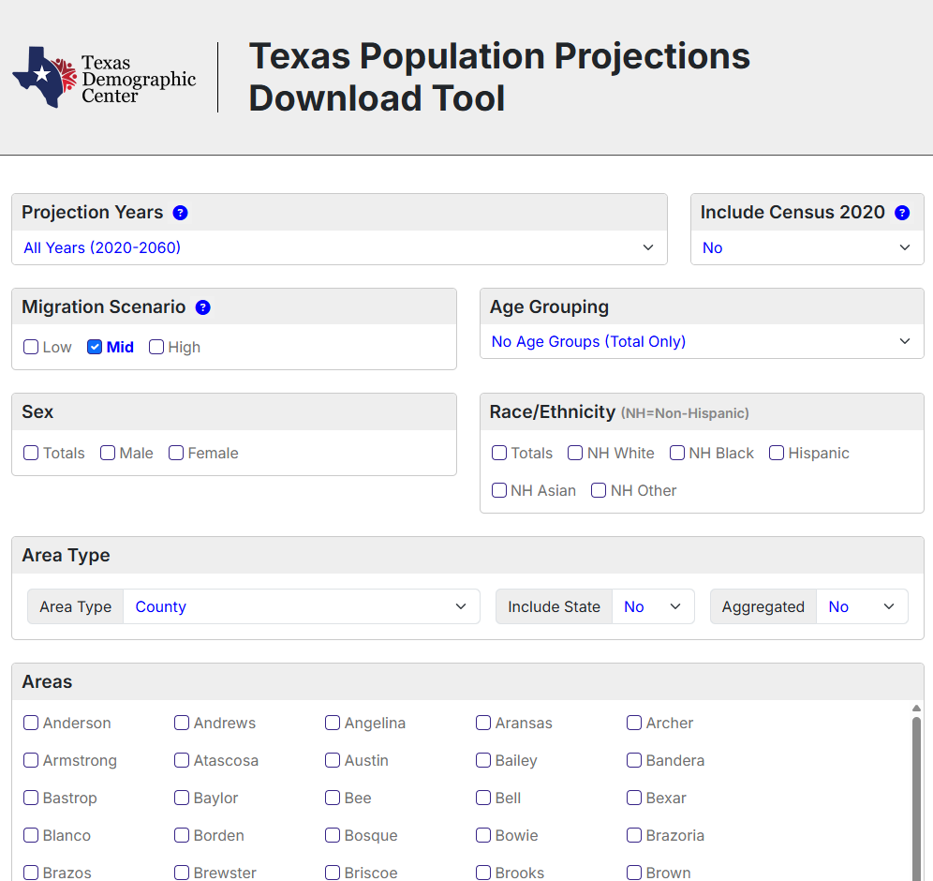
TDC Projections Data Tool

Slide 12
Projected Population Growth in Texas with Various Migration Scenarios
Source: Texas Demographic Center, Vintage 2022 and 2024 Population Projections

Slide 13
Projected Components of Change under the Mid Migration Scenario
Source: Texas Demographic Center, Vintage 2024 Population Projections

Slide 14
Projected Population by Race/Ethnicity
2020-2060
Mid Migration Scenario
All race/ethnic groups are projected to grow in size except for the non-Hispanic White.
Hispanics will gain the most population, while NH Asians will experience the fastest growth
Source: Texas Demographic Center, Vintage 2024 Population Projections, Mid Migration Scenario

Slide 15
Projected Population by Age
2020, 2040, and 2060
Mid Migration Scenario
22%
18%
Texas will continue to age in the next few decades.
The 65+ group will grow fastest.
Growth among those under 18 will slow and begin to decline.
The working-age population will grow and maintain a stable share of the total population.
13%
60%
60%
62%
Total Population
29.1M
37.1M
42.6M
Source: Texas Demographic Center, Vintage 2024 Population Projections, Mid Migration Scenario

Slide 16
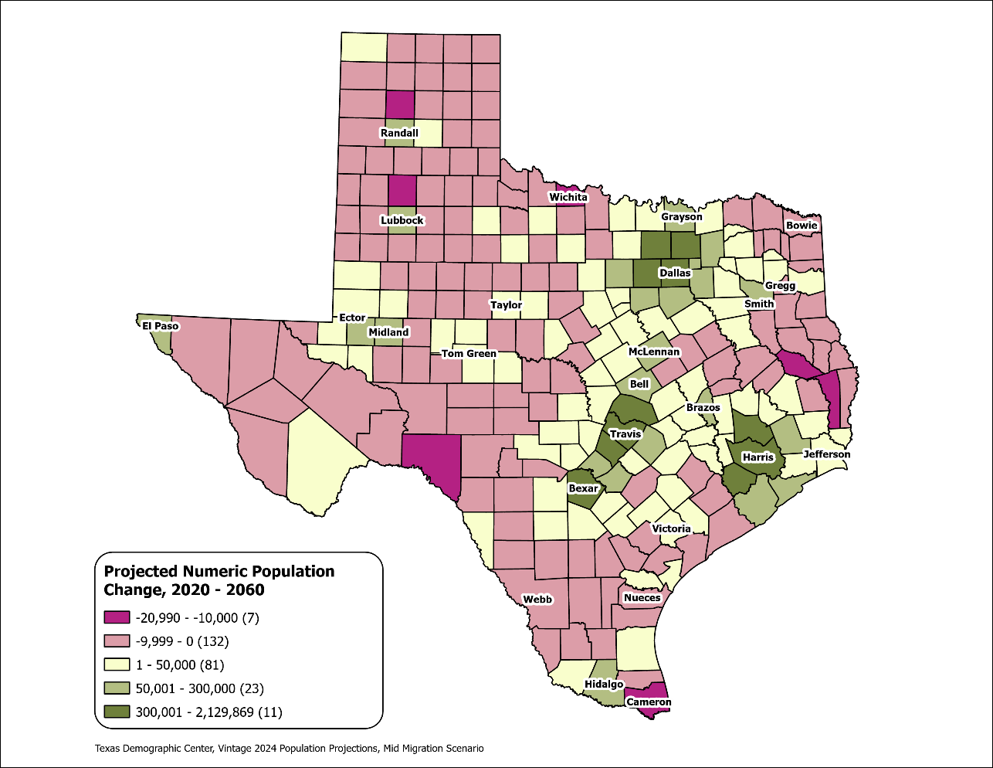
Texas Counties
Projected Population Numeric Change 2020-2060
Mid Migration Scenario
139 Counties are projected to lose population
Current MSA counties will account for 99% of the state’s growth from 2020 to 2060
The four MSAs within the TX Triangle will increase their share of population from 67% to 74%
Source: Texas Demographic Center, Vintage 2024 Population Projections, Mid Migration Scenario

Slide 17
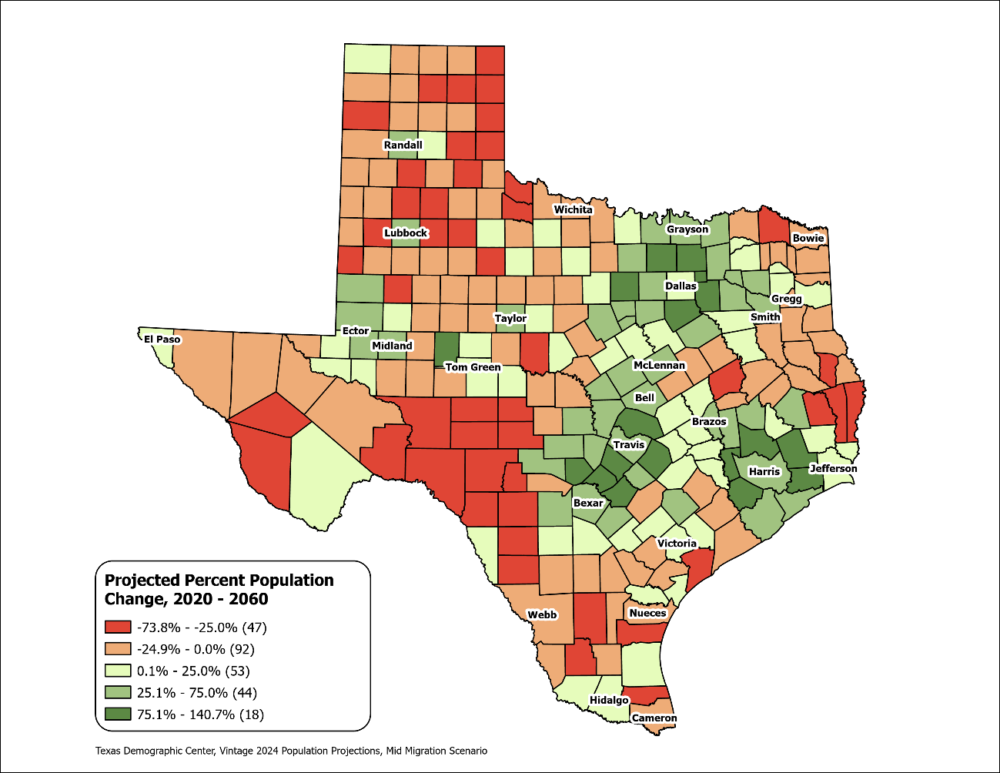
Texas Counties
Projected Population Percent Change 2020-2060
Mid Migration Scenario
Suburban ring counties in the triangle area will see the fastest growth rates.
Source: Texas Demographic Center, Vintage 2024 Population Projections, Mid Migration Scenario

Slide 18

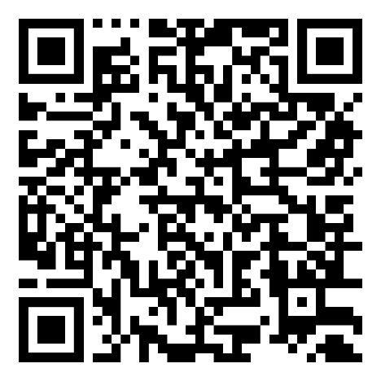
Projection Story Map

Slide 19
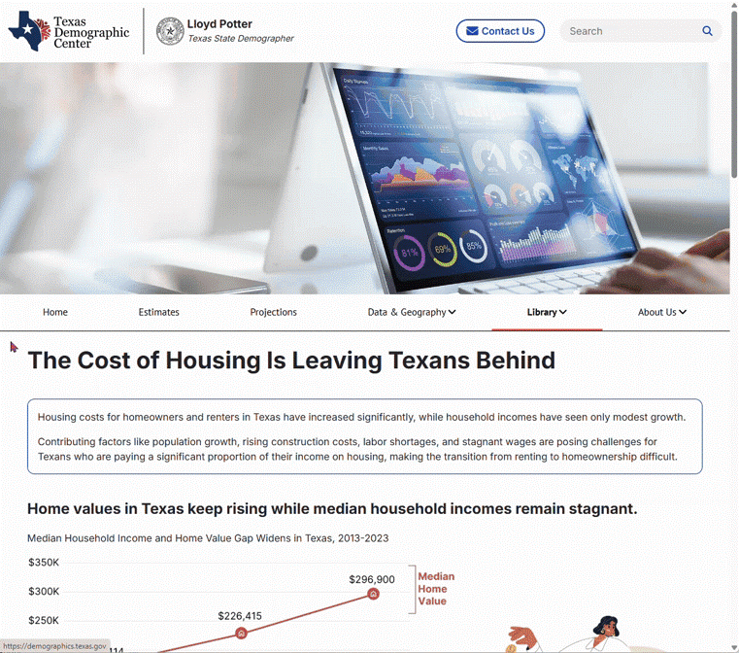
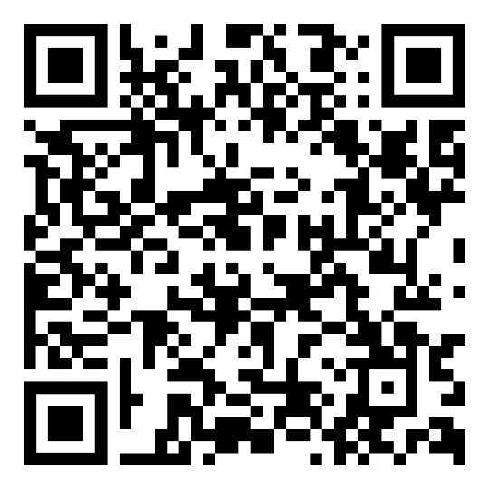
The Cost of Housing Is Leaving Texans Behind
Visualization

Slide 20
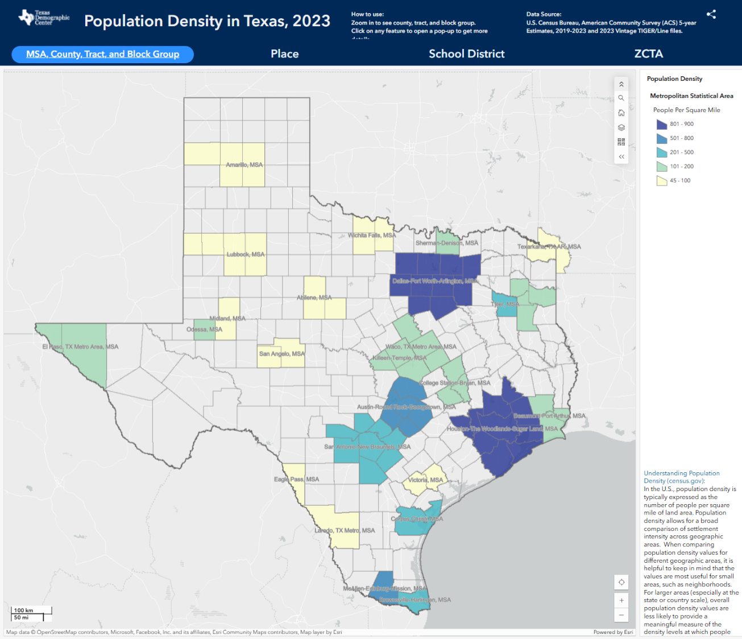
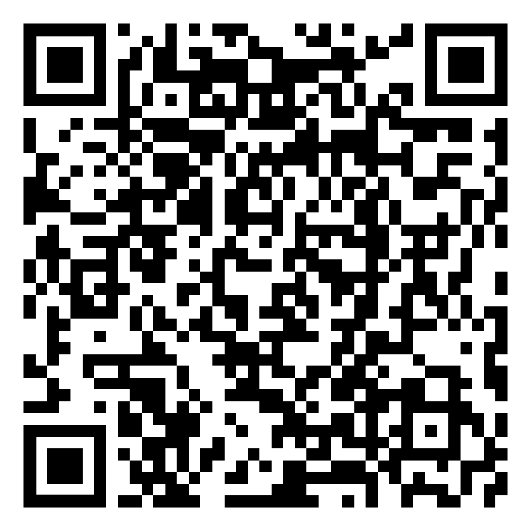
Population Density in Texas, 2023
Interactive Tools

Slide 21
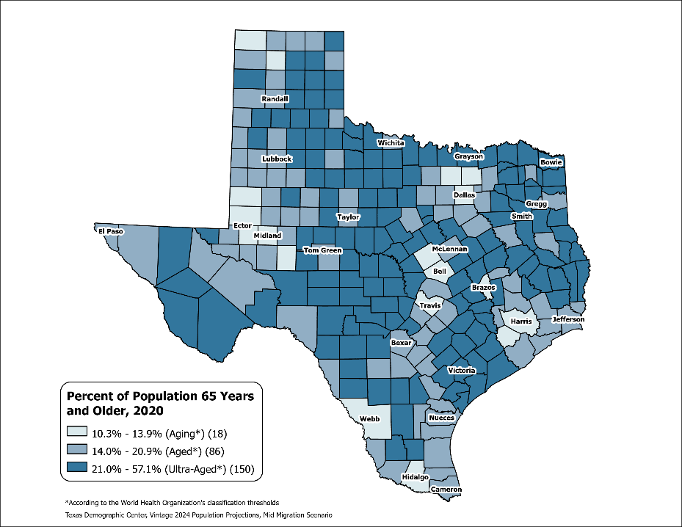
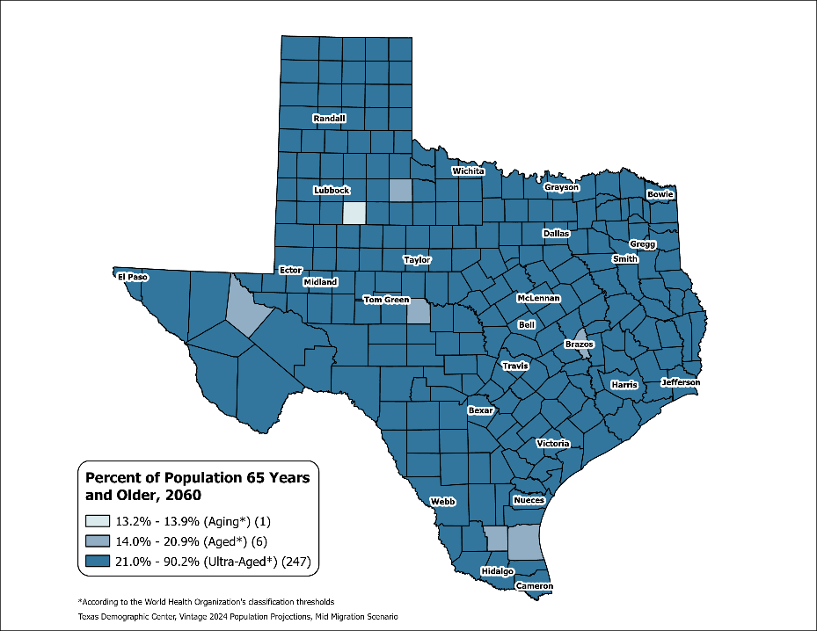
County Aging Map – Using the % of 65+ to Measure
Viz of the Week
Texas 2020: Aging (13.5%)
Texas 2060: Ultra-Aged (21.7%)
Source: Texas Demographic Center, Vintage 2024 Population Projections, Mid-Migration Scenario

Slide 22

Coming up
🗺️ TDC Population Projection Story Map
  A dynamic blend of narratives, interactive maps, and visualizations that illustrate how Texas’s population is expected to change over the next 40 years
🧪 “Special” Projections
  These go beyond basic population numbers to explore how demographic changes affect other areas:
  👷 Labor Force – Who will be working?
  🏠 Household – How will living arrangements shift?
  💰 Income – What might income distributions look like?
  🧭 Other? – Population projections with different development scenarios
We would like to hear from you!!

Slide 23
Preparing for the 2030 Census

Slide 24
Preparing for the 2030 Census (cont.)
Between 2010- 2020 Texas ranked #1 in numeric growth adding 3.9 million new Texans
YET 2020 Census: Texas was one of 6 states with an undercount (approximately 500K people)
Undercounting the population costs us billions in lost funding for infrastructure, health care, social services
Participate in the 2027 Local Update Census Addresses (LUCA) to ensure the Census Bureau has every address in your city or county.

Slide 25
What is LUCA?
LUCA (Local Update of Census Address) authorizes the Census Bureau to provide addresses to officials of tribal, state and local governments who agree to conditions of confidentiality.
LUCA participation is the most direct method and only opportunity local governments can provide input on residential addresses to the Census Bureau before the 2030 Census.
Highest Elected Officials (or designee) who agree to the conditions of confidentiality will receive a residential address list for their jurisdiction, and have the options to provide suggestions to:
  Add missing addresses;
  Delete addresses that do not exist;
  Update the geographic location of addresses (move from one Census block to another);
  Convert living quarter type (for example a non-residential building to a residential building)
Participation in LUCA is optional but highly recommended for an accurate Census count in 2030.
Notes:
Census Address List Improvement Act of 1994 (Public Law 103-430)
Title XIII Confidentiality

Slide 26
Who Can Participate in LUCA?
Eligible governments include:
States
Counties
Cities (incorporated places)
Townships (minor civil divisions)
Federally recognized Tribal Nations with a reservation and/or off-reservation trust lands
Highest elected/appointed officials can designate LUCA participants for their jurisdiction. This may include direct employees, interns, contractors, or designating alternate reviewers, such as county, state data center, or regional planning agency.
Notes:
Census Address List Improvement Act of 1994 (Public Law 103-430)
Title XIII Confidentiality

Slide 27
LUCA Timeline
Phase I (Prep) Spring 2027-Fall 2027: LUCA participants may choose to access the Census Bureau’s address inventory to review the address block count list for their geographic jurisdiction.
Phase II (Review and official submission) Fall 2027- March 31, 2028 (DEADLINE): LUCA participants determine the following:
  The address counts for their geographic jurisdiction are accurate; or
  Some address counts are inaccurate and may submit missing addresses, location information, or delete inaccurate addresses.
Phase III (Feedback and Appeals) April 2028- Sept. 2029: LUCA participants will have access to the results and check if the Census Bureau incorporated their address count submissions. There will be an appeal process through the Office of Management and Budget.
Phase IV (Closeout) September 2029: Final closeout for LUCA and Census Bureau begins process for 2030 Decennial Census.
Source: U.S. Census Bureau, Local Update of Census Addresses (LUCA) Operation
Notes:
Census Address List Improvement Act of 1994 (Public Law 103-430)
Title XIII Confidentiality

Slide 28
What Local Governments Can Do Now
Visit Census Bureau 2030 LUCA website to learn more about the operation.
Obtain data on residential addresses (911, residential addresses from commercial contractors, etc.)
Identify staff members or contractors who have technical skills to utilize the Census Bureau’s Address Count Listing to review housing count units and compare with your own data.
Plan for budget allocation to ensure participation in 2027 (staff or contractors).
Look out for updates from TARC or TDC newsletter for webinars or training in 2026.
Notes:
Census Address List Improvement Act of 1994 (Public Law 103-430)
Title XIII Confidentiality

Slide 29
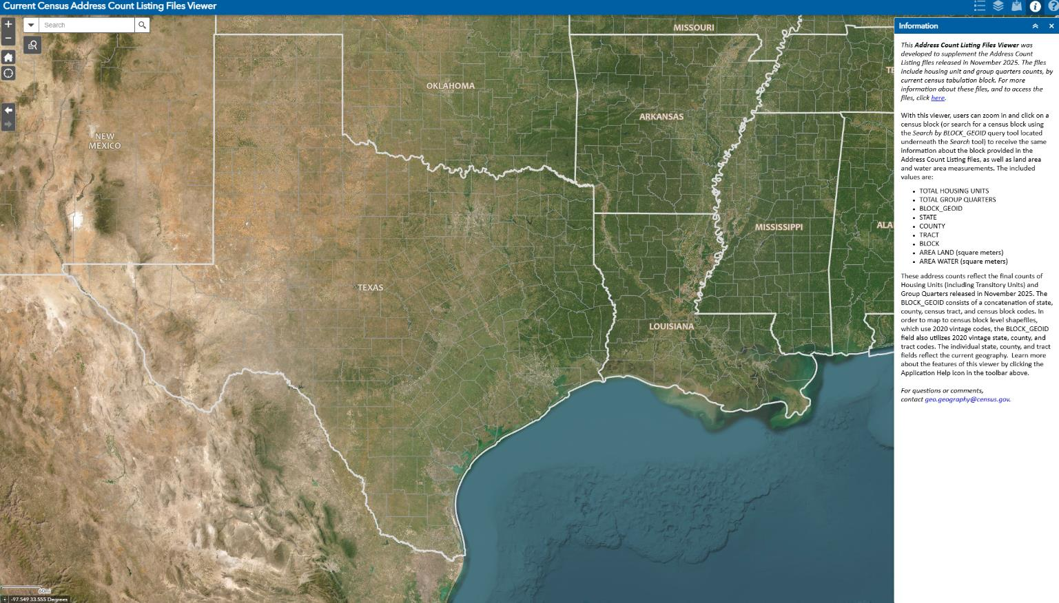
Census Address Count Listing
Source: U.S. Census Bureau, Current Census Address Count Listing Files Viewer
Notes:
Census Address List Improvement Act of 1994 (Public Law 103-430)
Title XIII Confidentiality

Slide 30
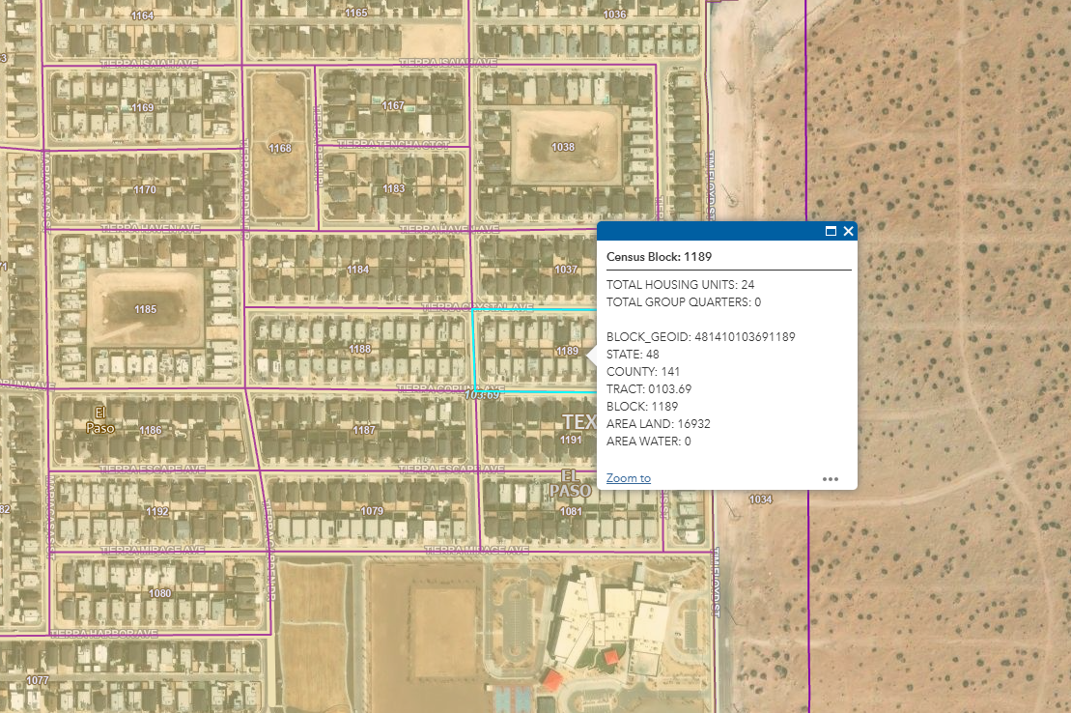
Census Address Count Listing (cont.)
El Paso County
Census Block: 1189
Total Housing Units: 24
Source: U.S. Census Bureau, Current Census Address Count Listing Files Viewer
Notes:
Census Address List Improvement Act of 1994 (Public Law 103-430)
Title XIII Confidentiality

Slide 31
Preparing for the LUCA Initiative
Texas Demographic Center LUCA initiatives:
Form a Statewide LUCA Advisory Committee with key TDC affiliate organizations and other state offices
Develop an awareness campaign to help local governments prepare via presentations, webinars, strategic partnerships, and technical assistance.
Join our efforts to Make Texas Count!

Slide 32
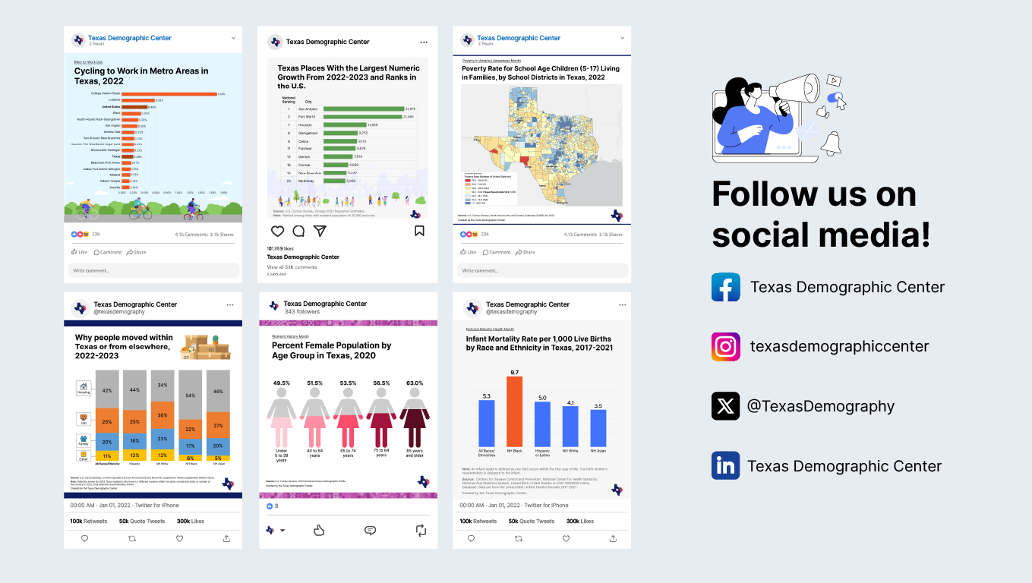
Follow us on social media

Slide 33




Texas Demographic Center 2026

Slide 34
Helen You, Ph.D.
Monica Cruz, Ph.D.
(210) 458-6543
tdc@utsa.edu
demographics.texas.gov/

Slide 35
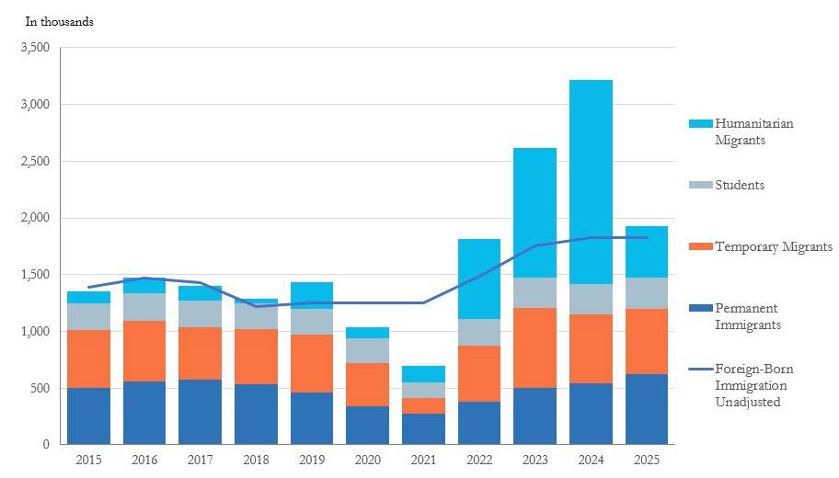
Estimates of Foreign-Born Immigration and
Benchmark Data by Categories, 2015-2025
Source: https://www.census.gov/newsroom/blogs/random-samplings/2026/01/historic-decline-in-net-international-migration.html.
U.S. Census Bureau, American Community Survey 1-year file 2015-2019 and 2022 to 2024; Department of Homeland Security; Department of State; International Institute of Education

