Slide 1
Texas Demographic Characteristics and Future Trends
March 24, 2026
Austin, TX
Presented to:
Texas Automobile Association

Slide 2




About our organization
Major Function
Produce annual population estimates and biennial population projections
Other Services
Disseminate demographic and socioeconomic information from the Census Bureau and other reliable sources.
Provide training and technical expertise.
Custom data analyses.
State Demographer
Lloyd B. Potter, Ph.D.
Affiliated with
The University of Texas at San Antonio
Institute for Demographic and Socioeconomic Research (IDSER)
Partnerships
U.S. Census Bureau
TDC Affiliates

Slide 3


Texas Numeric Growth
Texas’s population surpassed
31.7 million
and ranked #1
in the U.S. on numeric growth
between 2024-2025.
Source: U.S. Census Bureau, Vintage 2024 Population Estimates

Slide 4

New 2025 Estimates Show Texas Growth but at Slower Rate
Newly Released Data
Texas Total Population 2025
31.7M
391K
1.2%
Numeric increase
Percent increase
Growth from 2024

Slide 5

Population increased by
1,072 new Texans daily
between 2024 and 2025.
Source: U.S. Census Bureau, Population Estimates, 2022 and 2023

Slide 6
Texas Components of Population Change 2024-2025
1,072 New Texans Daily
Source: U.S. Census Bureau, Vintage 2025 Population Estimates

Slide 7
Texas Daily Population Growth and Components of Change 2020-2025
Drop in Net Migration Slows Texas Population Growth
917
1,494
1,647
1,642
1,072
Daily Average Population Change
Source: U.S. Census Bureau, Vintage 2025 Population Estimates

Slide 8
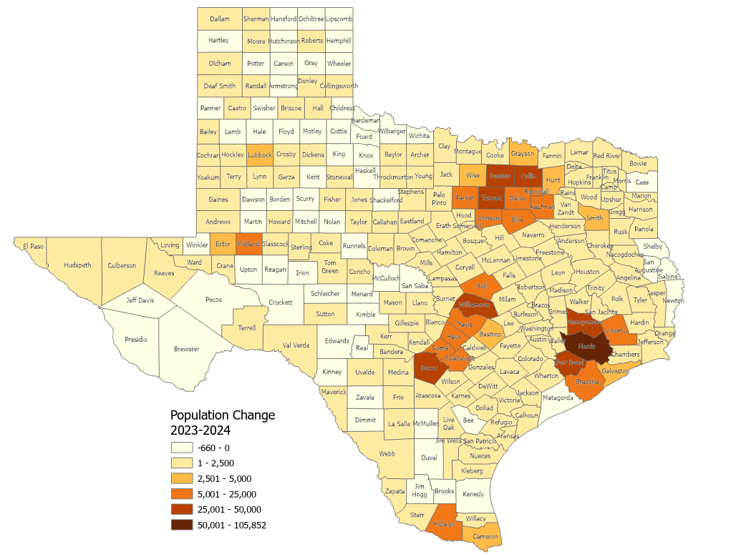
Estimated Numeric Change, Texas Counties, 2023-2024
65 (26.5%) of Texas counties lost population
Population Change
2023-2024
-660 - 0
1 – 2,500
2,501 – 5,000
5,001 – 25,000
25,001 – 50,000
50,001 – 105,852
Source: U.S. Census Bureau, Vintage 2023 and 2024 Population Estimates

Slide 9
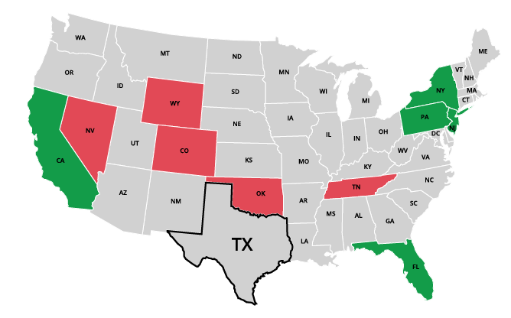
Top Net Migration To and From Texas: Leading States in 2024
Moving to Texas
California | 31,714
2. New York | 11,909
3. New Jersey | 8,148
4. Florida | 6,960
5. Pennsylvania | 5,730
Leaving Texas
1. Oklahoma | -9,495
2. Tennessee | -5,210
3. Colorado | -4,588
4. Wyoming | -2,342
5. Nevada | -2,180
Source: U.S. Census Bureau, 2024 State-to-State Migration Flows Statistics.
Notes:
Note: Data displayed are estimates based on a sample survey and are subject to error.
Caption: Latest U.S. Census Bureau Data: Around 550K domestic migrants moved to Texas in 2024, while 480K left for other states. Texas saw the largest net inflows of migrants from California, New York, and New Jersey and net outflows to Oklahoma, Tennessee, and Colorado.

Slide 10
Texas Cities by Largest Numeric Growth from 2023 to 2024 and National Ranking
National
Ranking
City
1
2
3
4
8
9
10
11
18
21
Source: U.S. Census Bureau, Vintage 2024 Population Estimates

Slide 11
Texas Cities by Fastest Growth Rate from 2023 to 2024 and National Ranking
National
Ranking
City
1
2
4
5
8
11
13
17
18
22
Source: U.S. Census Bureau, Vintage 2024 Population Estimates

Slide 12
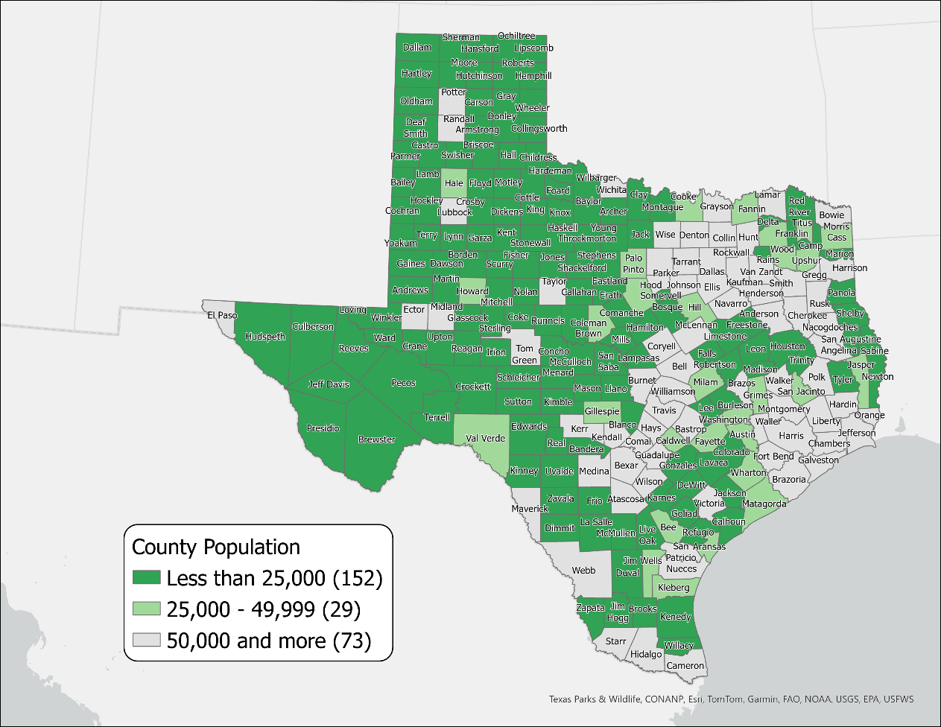
Texas Rural Counties by Population, 2023
181 Rural Counties
Total pop.= 2.4 million (8.1% of Texas pop.)
88 of these counties lost population between 2020-2023
SOURCE: US Census Bureau, Population Estimates, 2022 Vintage

Slide 13

Median Household Income and Home Value
Gap Widens in Texas, 2013-2023
Median
Home
Value
Median
Household
Income
$
$
$
Source: U.S. Census Bureau, American Community Survey, 1-Year, 2013, 2018, and 2023.
Note: 2023 Inflation-Adjusted Dollars.
Notes:
The median household income has not kept up with the cost of housing in TX. Population growth, rising costs for building materials, and labor shortages have affected the supply of homes and increased their cost, making it difficult for many Texans to purchase and own a home.

Slide 14








Housing Tenure and Costs in Texas
11.2 million occupied housing units
Homeowners
Renters
62.6% homeowners in Texas
37.4% renters in Texas
Median mortgage: $2,071/month
Median rent: $1,471/month
Cost burden: 30%
Cost burden: 53%
Source: U.S. Census Bureau, 2023 American Community Survey, 1-Year Estimates

Slide 15
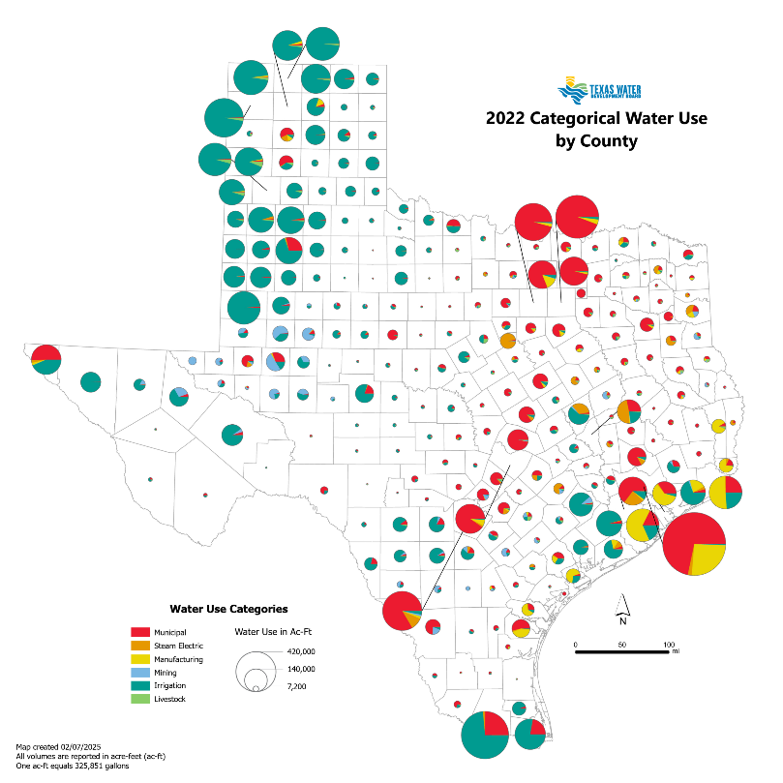
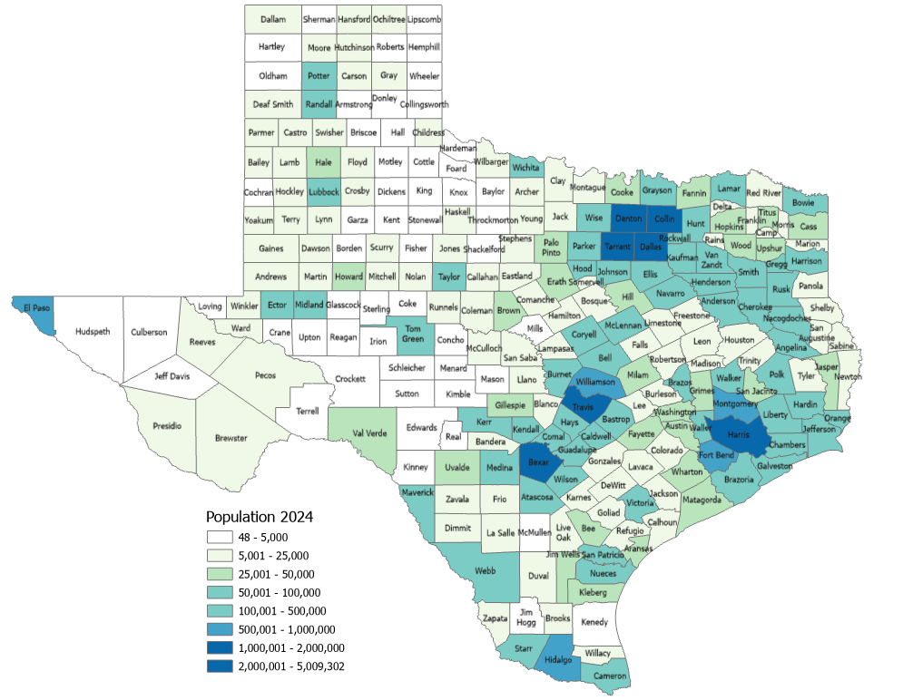
Water Use and Population
Estimated Population, Texas Counties, 2024
Source: Texas Water Development Board. Texas Water Use Summary for 2022; U.S. Census Bureau, Vintage 2024 Population Estimates.

Slide 16
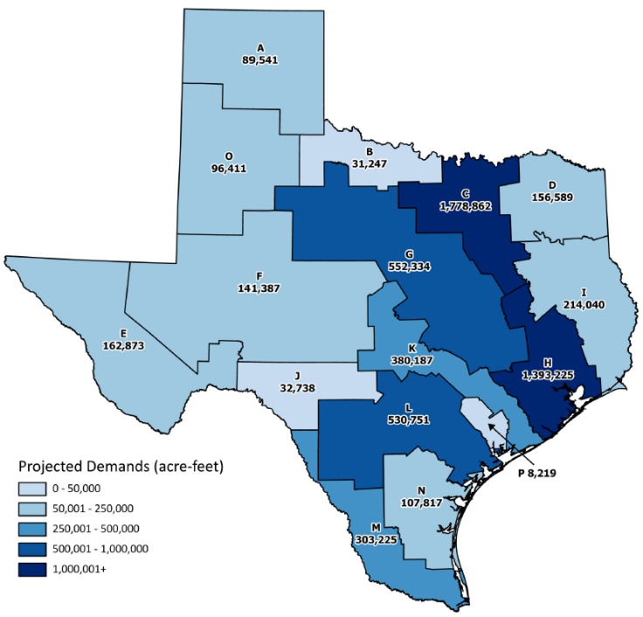
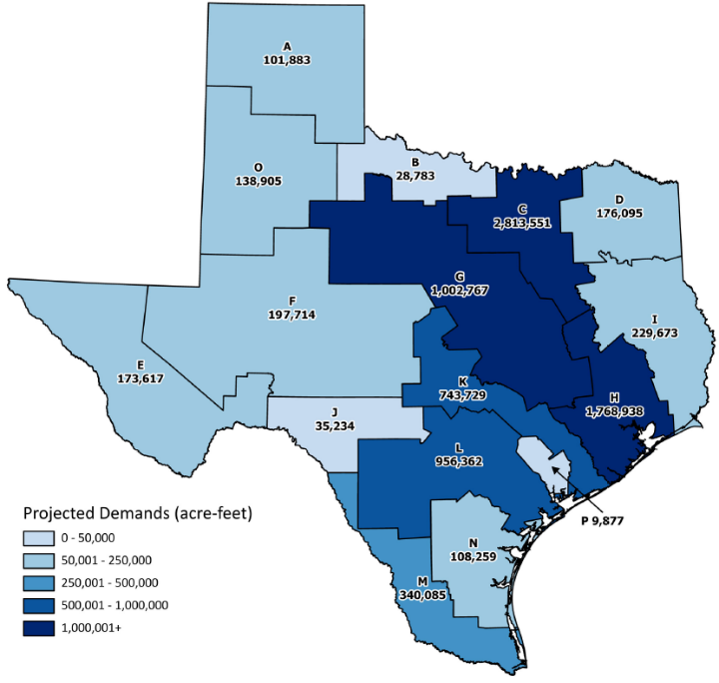
Projected Municipal Water Demands
2030
2080
Source: 2022 State Water Plan, Texas Water Development Board

Slide 17
A Look into the Future

Slide 18
Projected Population Growth in Texas with Various Migration Scenarios
2020-2060
42.6 million by 2060
(Mid migration scenario)
Source: Texas Demographic Center, Vintage 2022 and 2024 Population Projections

Slide 19
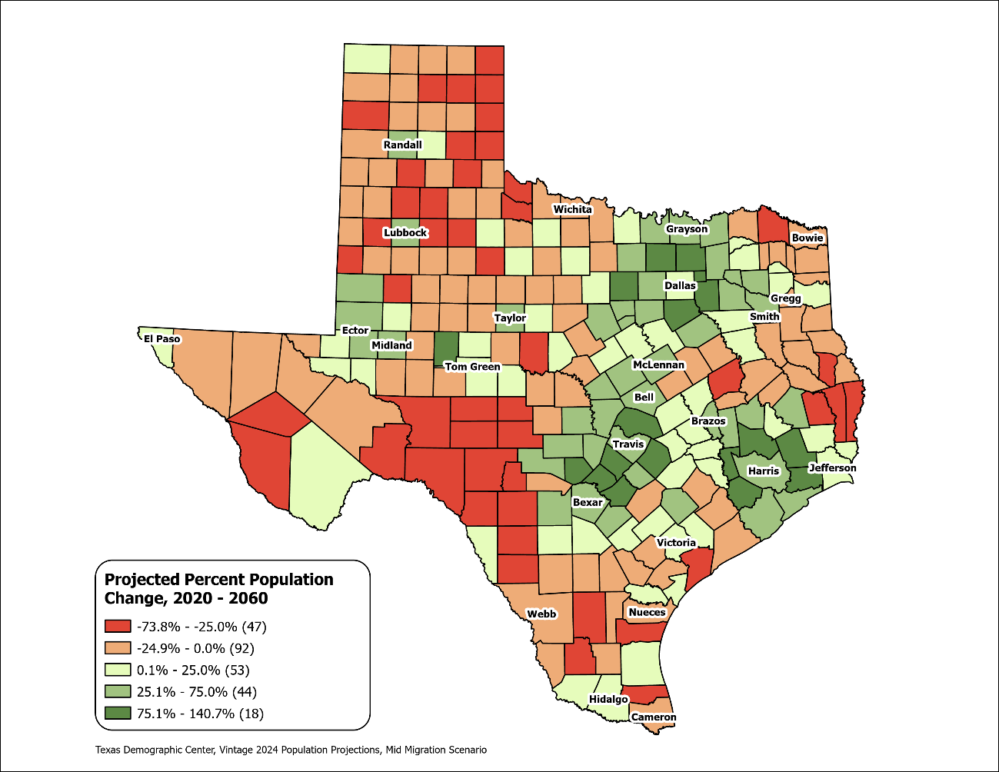
Texas Counties
Projected Population Percent Change 2020-2060
Mid Migration Scenario
Suburban ring counties in the triangle area will see the fastest growth rates.
Source: Texas Demographic Center, Vintage 2024 Population Projections, Mid Migration Scenario

Slide 20
Projected Population by Age
2020, 2040, and 2060
Mid Migration Scenario
22%
18%
Texas will continue to age in the next few decades.
The 65+ group will grow fastest.
Growth among those under 18 will slow and begin to decline.
The working-age population will grow and maintain a stable share of the total population.
13%
60%
60%
62%
Total Population
29.1M
37.1M
42.6M
Source: Texas Demographic Center, Vintage 2024 Population Projections, Mid Migration Scenario

Slide 21
Preparing for the 2030 Census

Slide 22
Preparing for the 2030 Census (cont.)
Between 2010- 2020 Texas ranked #1 in numeric growth adding 3.9 million new Texans
YET 2020 Census: Texas was one of 6 states with an undercount (approximately 500K people)
Undercounting the population costs us billions in lost funding for infrastructure, health care, social services
Participate in the 2027 Local Update Census Addresses (LUCA) to ensure the Census Bureau has every address in your city or county.

Slide 23
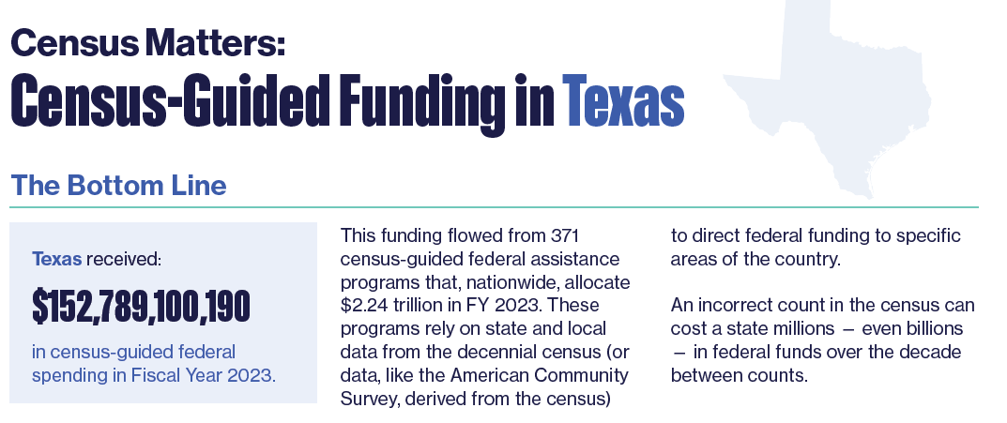
Why Good Population Data Matters
Texas received over
$152 Billion
in Census-guided federal assistance in 2023
Project on Government Oversight report
Source: Census Matters: Why an Accurate Count is Essential to Funding Our Communities | Project On Government Oversight

Slide 24
Preparing for the 2030 Census (cont..)
Texas Goal: Increase participation in LUCA. What is LUCA?
LUCA (Local Update of Census Address) authorizes the Census Bureau to work with local governments to provide updates on residential housing units.
Correct Residential Addresses is what the Census Bureau will use for their Master Address File to disseminate the 2030 Census survey.
LUCA participation is the most direct method and only opportunity local governments can provide input on residential addresses to the Census Bureau before the 2030 Census.
Participation in LUCA is optional but highly recommended for an accurate Census count for your community in 2030.
Notes:
Census Address List Improvement Act of 1994 (Public Law 103-430)
Title XIII Confidentiality

Slide 25
Who Can Participate in LUCA?
Highest Elected Officials from eligible governments include:
States
Counties
Cities (incorporated places)
Townships (minor civil divisions)
Federally recognized Tribal Nations with a reservation and/or off-reservation trust lands
Notes:
Census Address List Improvement Act of 1994 (Public Law 103-430)
Title XIII Confidentiality

Slide 26
LUCA Timeline 2027-2028
Spring 2027-Fall 2027: (Prep Phase) LUCA participants may access the Census Bureau’s address inventory to review the address block count list for their geographic jurisdiction.
Fall 2027- March 31, 2028 (DEADLINE): (Review and official submission) LUCA participants officially submit their updates to the Census Bureau.
Highest elected/appointed officials can designate LUCA participants for their jurisdiction. This may include direct employees, interns, contractors, or designating alternate reviewers, such as county, state data center, or regional planning agency.
Source: U.S. Census Bureau, Local Update of Census Addresses (LUCA) Operation
Notes:
Census Address List Improvement Act of 1994 (Public Law 103-430)
Title XIII Confidentiality

Slide 27
What Local Governments Can Do Now
Visit Census Bureau 2030 LUCA website to learn more about the operation.
Obtain data on residential addresses (911 addresses, residential addresses from local government sources, commercial contractors, etc.)
Identify staff members or contractors who have technical skills to utilize the Census Bureau’s Address Count Listing to review housing count units and compare with your own data.
Plan for budget allocation to ensure participation in 2027 (staff or contractors, if needed).
Look out for updates from the Texas Demographic Center newsletter for webinars or training in 2026.
Join our efforts to Make Texas Count!
Notes:
Census Address List Improvement Act of 1994 (Public Law 103-430)
Title XIII Confidentiality

Slide 28




Visit our website
Sign up for our newsletter
Follow us on social media

Slide 29


Texas Demographic Center 2026

Slide 30
Monica Cruz, Ph.D.
(210) 458-6543
tdc@utsa.edu
demographics.texas.gov/

