Slide 1
Texas Demographic Center (TDC) Population Projections:
Data, Method, and Process
Presented at
TDC Webinar Series
Mar 21, 2024

Slide 2








Table of Contents

Slide 3
TDC Population Projection Overview

Slide 4
What are population projections?
Projections are
“conditional statements about the future”*
TDC produces projected populations based on a set of assumptions we make about future population changes
  -- Projections are less accurate when future conditions deviate from the assumptions.
Data driven:
  -- Identify patterns from historical data
Informed by the most current research and data in the demographic field
Adopt a well-established model used by the UN, the United States and many other states in the U.S.
*Smith S.K., Tayman J., and Swanson D.A. (2013). A Practitioner’s Guide to State and Local Population Projections. Springer.

Slide 5
WHAT projections do we produce?
Total population and population by age, race, and sex for Texas and all its counties;
Single year of age;
5 race/ethnic groups: Hispanic, NH White, NH Black, NH Asian, and NH Other;
From the most recent Census (2020) out to 40 years in the future (2060);
Two migration scenarios are provided.

Slide 6
WHEN are the projections released?
Produced every two years;
Release in the fall of even-numbered years
Latest version: Vintage 2022
  Delayed in release
  Limited demographic details
  Downloadable data files publicly available
Upcoming: Vintage 2024
  Scheduled release by the end of November 2024
  Demographic details (age, race/ethnicity, and sex)
  Downloadable data files and a custom table tool

Slide 7
HOW are our population projections used
Population projections do not provide a definite prediction of the future. They can be utilized or modified to enhance decision-making in practical situations.
  Planning for infrastructure
  Denominator for prevalence/enrollment rates
  Allocation Factor
  Input for other forecasting models
  Add a budget cap in accordance with population growth
  Benchmark for local projections
  Grant Applications
We want to hear from you: Drop us an email (tdc@utsa.edu) and tell us how you use our projections

Slide 8
The Method and the Assumptions

Slide 9
Components of Population Change
29,145,505
Natural Change
Births - Deaths
Net Migration
In - Out
Components
of Population Change
Source: U.S. Census Bureau. Decennial Censuses 2010 and 2020

Slide 10

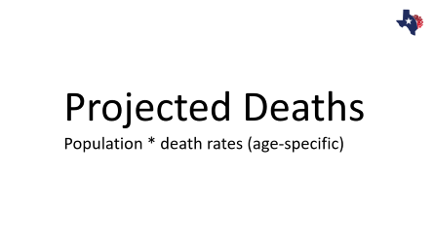




The Cohort Component Model for Population Projections
  Future Population Current Population
The components of population change (fertility, mortality, and net migration) are projected separately for each birth cohort (persons born in a given year)

Slide 11
Projected Births
Female Population 15-49 * ASFR

Slide 12
Fertility Rates Differ by Age, and Race/Ethnicity
TFR
The number of children that would be born to a woman
  if she were to live to the end of her childbearing years and bear children in accordance with age-specific fertility rates currently observed
The area Under the curve is TFR

Slide 13
Fertility Rates Differs by Rural/Urban Status
TFR
USDA Urban Influence Code
The higher the number, the more rural the counties are

Slide 14
Historical and Projected Total Fertility Rate
TFR

Slide 15
Assumptions for the Fertility Projections
Based on our analysis of the historical data and informed by research in the demographic field, we assume
Total fertility rates will continue to decline but at a slower pace;
Age-specific fertility rates will be stable within each race/ethnic group;
Rural-urban differences in fertility rates will persist.

Slide 16
Projected Deaths
Population * death rates (age-specific)

Slide 17
Survival Rate Differ by Age, Sex and Race/Ethnicity

Slide 18
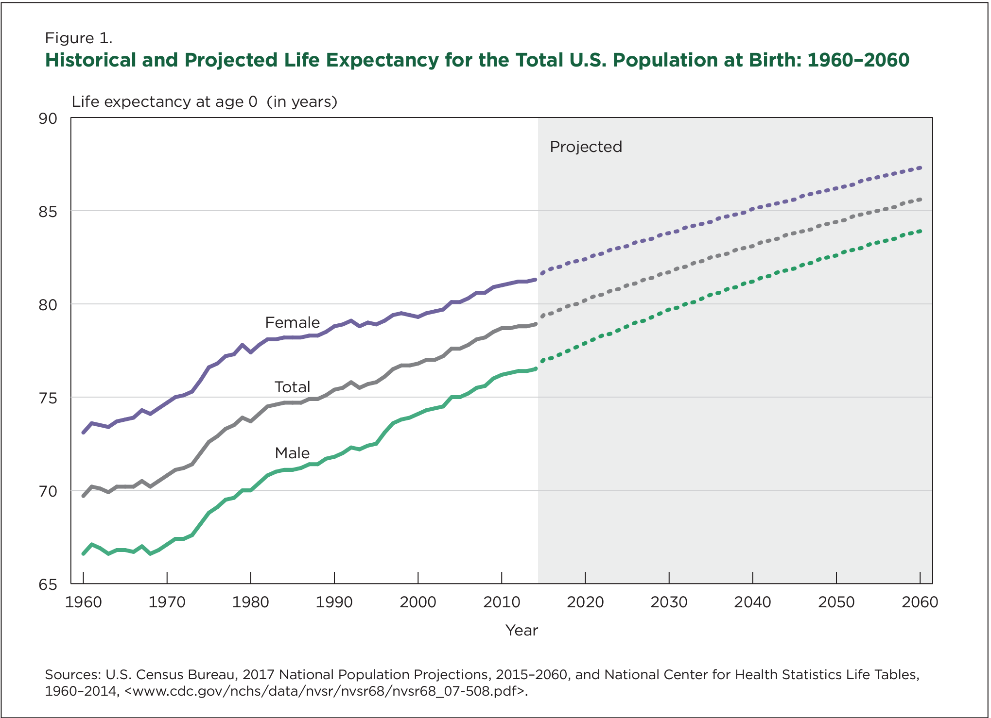
Historical and Projected Life Expectancy for the U.S.
Life Expectancy at Birth 2020
US: 77
Male: 74.2
Female: 79.9
Texas: 76.5
Male: 73.7
Female: 79.3
“Although life expectancy continues to rise, increases have slowed in recent years.”

Slide 19
Assumptions for the Survival Projections
Based on our analysis of the historical data and informed by research in the demographic field, we assume
Life expectancy and survival rates will continue to improve and will follow the pace of the nation as projected by the Census Bureau;
Age- and sex-specific survival rates will be stable within each race/ethnic group;
Counties will have the same rates as the State.

Slide 20
Projected Net Migrants

Slide 21
The Residual Method
Net Migrants = Population Change – Natural Increase
Net Migration Rate = Net Migrants / Base Population
Why did we choose this method:
The migration rates can be derived from two of the most reliable sources of population data -- the Vital Statistics and the Decennial Censuses
It can be applied to all the sub-population groups (age, race/ethnicity, and sex) and a wide range of geography
They are relatively consistent over time and across different regions of the U.S.

Slide 22
Migration Rates by Race/Ethnicity

Slide 23
Assumptions for the Net Migration Rates
The Two Migration Scenarios:
Mig 1.0
Assuming the migration rates between 2010-2020 hold throughout the projected years
Mig 0.5
Assuming the migration rates are half of those between 2010-2020 throughout the projected years

Slide 24
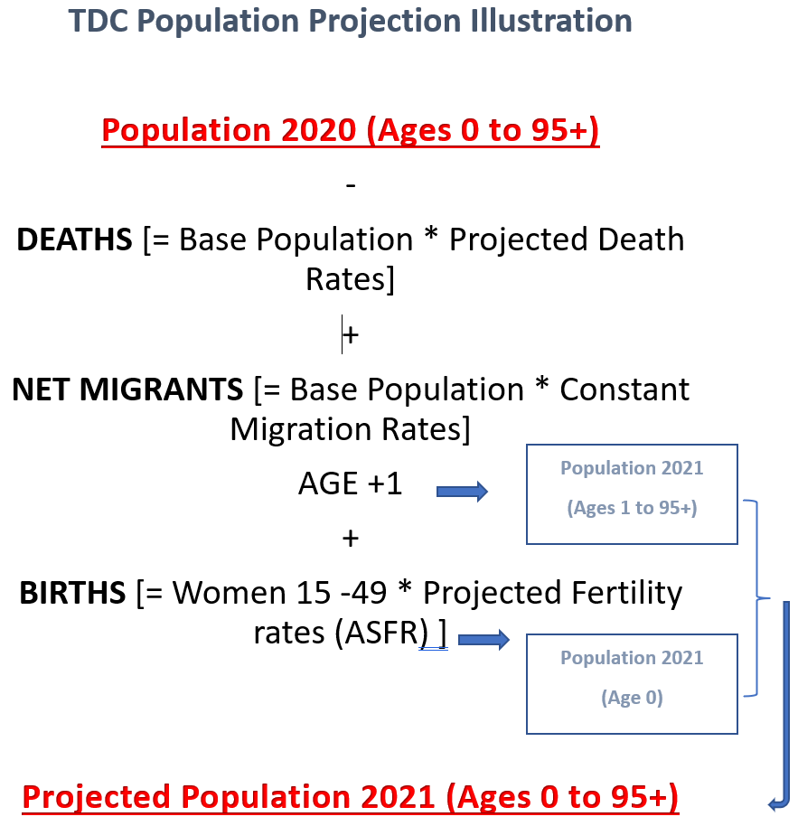

Slide 25
The Final Steps
The Rates are evaluated for reasonableness
Outliers/extreme values are replaced by broader age group rates, county total rates, or state rates
Projections by race/ethnicity are done separately for all the counties and the State. The county sums are then controlled to the state projection
Note: By using age, race, sex, and county-specific rates in the projections, these demographic factors and county differences are implicitly used as predictors of population change.

Slide 26
Other Considerations

Slide 27
Projection Evaluation
Census Count | TDC Projection | % Dif | PES shows Under Count
29,145,505 | 29,677,668 | 1.8% | 1.9%
SOURCE: Texas Demographic Center, Vintage 2014 and 2018, 2022 Population Projections

Slide 28
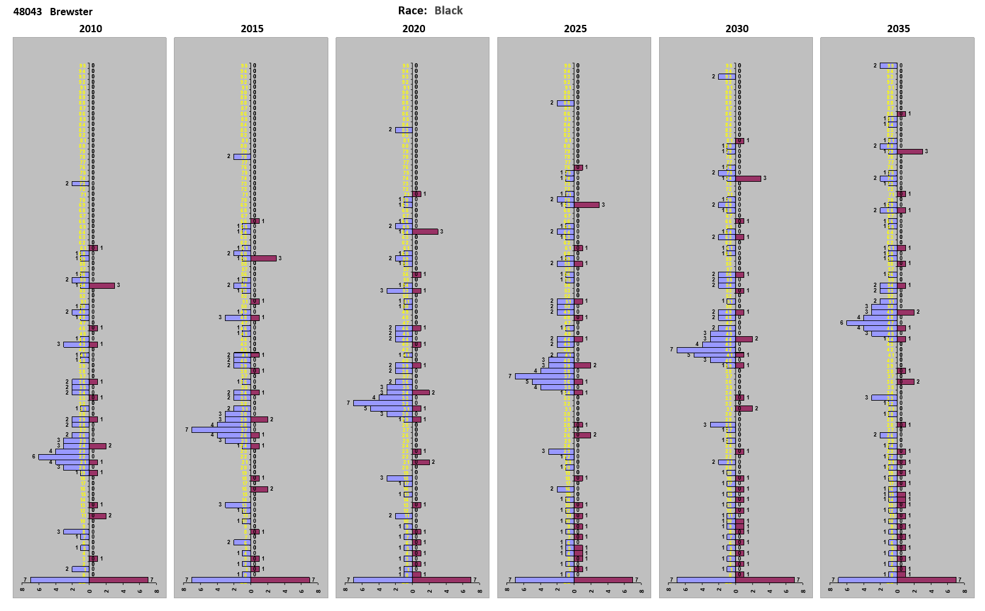
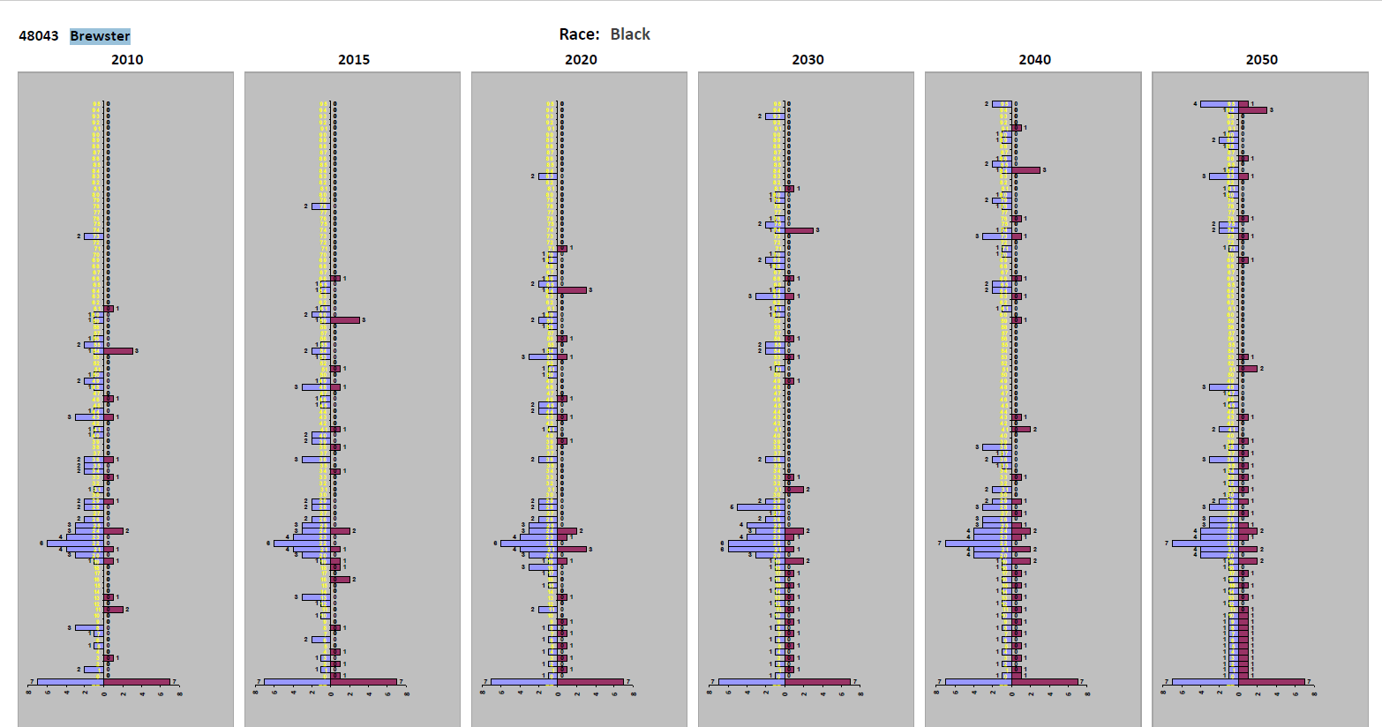
The “Special” Population
They are mostly Group Quarter Population
Treated the Same as the Household Population
Held in place without aging

Slide 29
Research on the 2020 Decennial Census
  The Alternative
  the “Blended” Base?
  -- Developed by the Census Bureau’s Population Estimates Program for the post-2020 population estimates
    Pros
  Has adjusted for child undercount
  Will smooth age to remove heaping
  Will be more consistent with other Census products (e.g ACS) using the estimates as the control
    Cons
  Use a modified race approach that’s different from TDC
  Base year will be different from the Census, and from year to year
  How to communicate with users ???
  The Differential Privacy → Injected noises/errors
  The Miscount
    Texas -1.92%;
    African American -3.30%;
    Hispanic -4.99%;
    Children (0-4) -5.4%
    Age Heaping
  Race/ethnicity
    Coding and processing

Slide 30
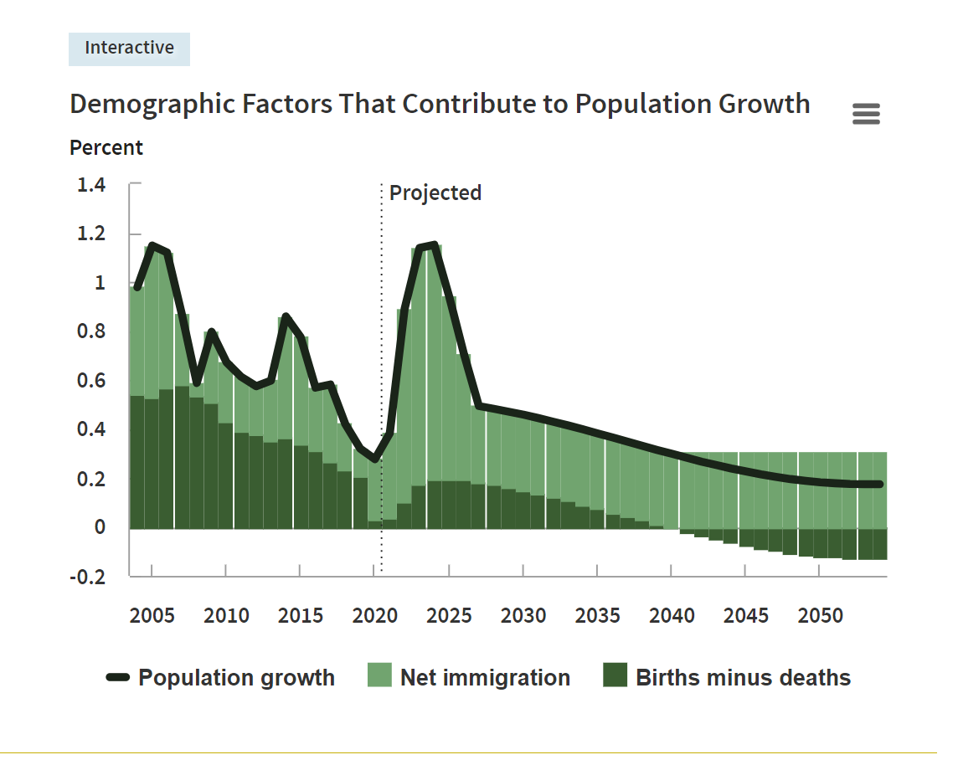
Disasters and Other Major Events?
Projections are usually not good at accounting for major events that have big impacts on the population such as
  The pandemic
  Fluctuation of international migration flow
  Oil industry
  Natural disasters
Common practice among demographers is to create alternative scenarios
An example to account for the recent immigration surge
Source: Congressional Budget Office. The Demographic Outlook: 2024 to 2054

Slide 31
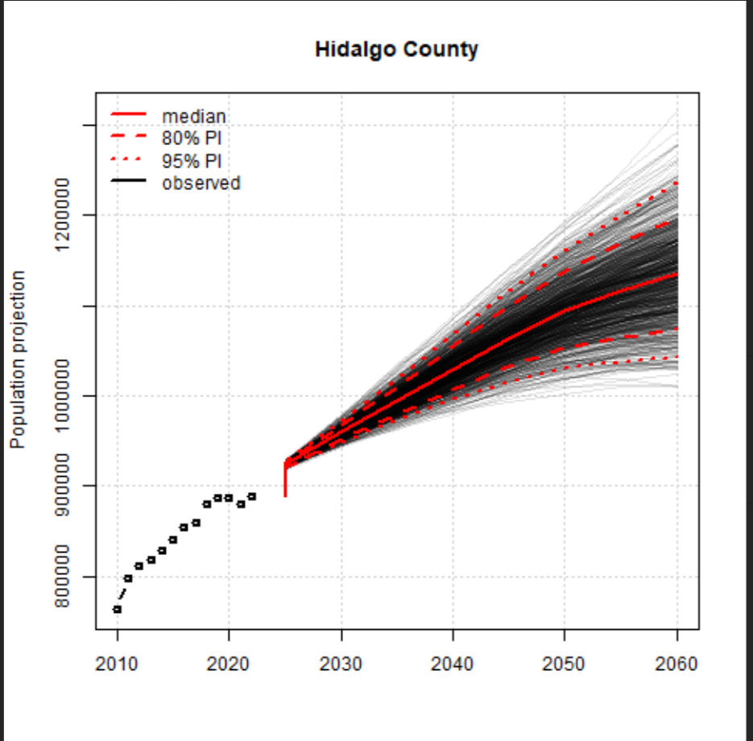
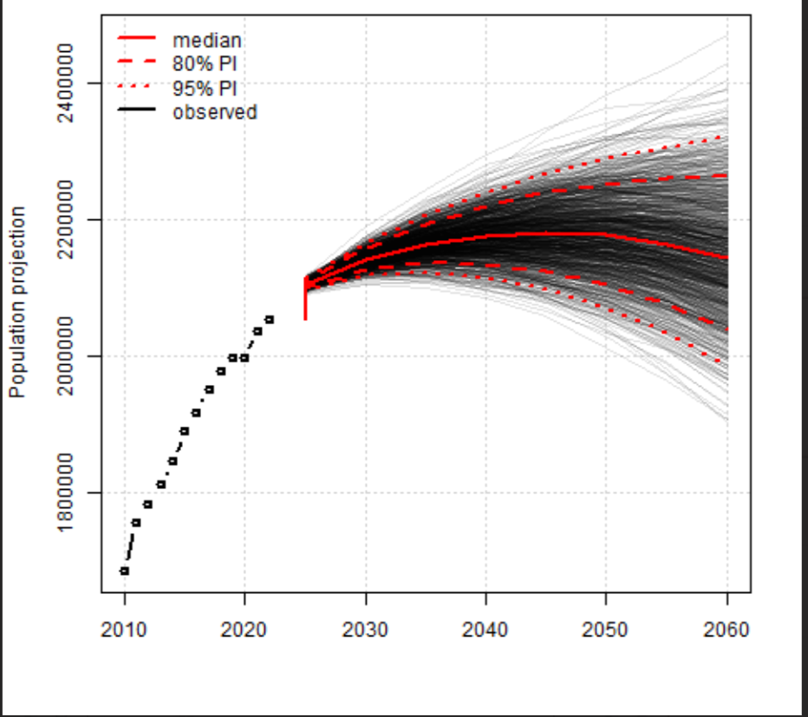
The Probabilistic Model

Slide 32
FAQs
What are the differences between projections and estimates?
  Estimates: of the past; uses existing data;
  Projections: of the future; uses projected data.
Which migration scenario should I use?
  We usually recommend 0.5 mig for the longer term and 1.0 mig for the shorter term usese;
  We also recommend checking against the latest estimates for specific areas.
Which vintage of projections should I use?
  We update our projections every other year to reflect the most recent demographic trends. So we strongly recommend our latest vintage of projections.
Do you use employment, building permits, and population density to project population?
  Currently, no. However, we can incorporate these data if a good projection source is available.
How do your projections compare with other projections and forecasts?
  Population projections are mainly driven by historical data and trends, whereas forecasts reflect the analyst’s views regarding the data, the future trajectories, and personal judgments.

Slide 33


Texas Demographic Conference
May 29-30 I Austin, TX
U.S. Census Bureau, American Community Survey
(ACS On the Road Event)
Higher Education Trends in Texas
Broadband Expansion
Water, transportation, economic development
Population projections

Slide 34
Questions and Comments?

Slide 35
Helen You, Ph.D.
(210) 458-6543
TDC@UTSA.edu
demographics.texas.gov/
@TexasDemography

